Slide 1

Fundamentals of functional and effective connectivity and their applications to neurodevelopmental and mental health conditions
Maria Dauvermann
Clinical Neuroimaging Lab
https://www.clinical-neuroimaging-lab.co.uk/
m.dauvermann@bham.ac.uk
27/08/25

Slide 2
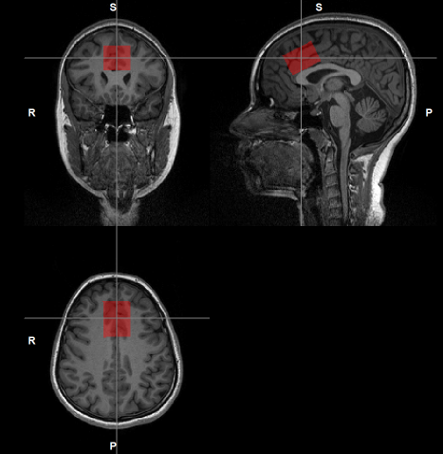
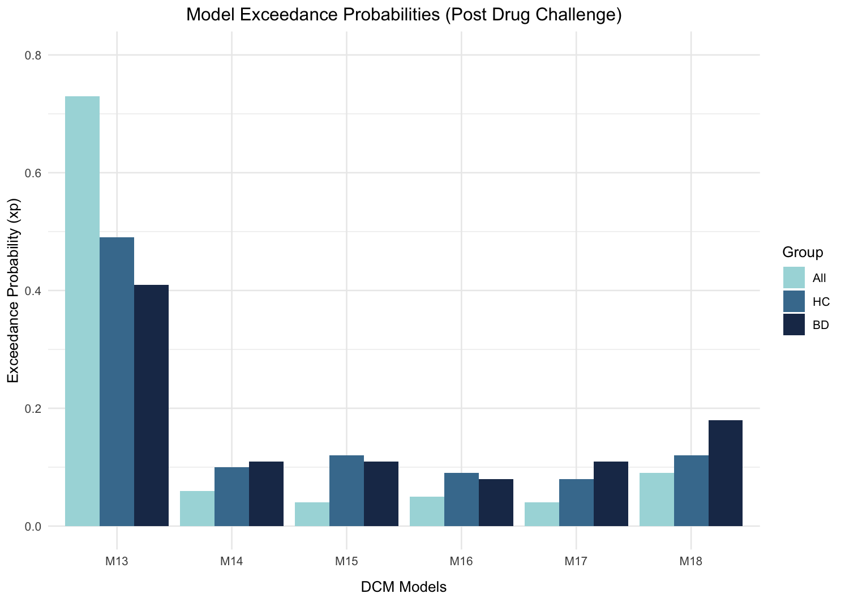
Research themes in psychotic disorders
NEUROBIOLOGY -
EFFECTIVE CONNECTIVITY
NEUROBIOLOGY –
GLUTAMATE
NEUROBIOLOGY - CHRONIC STRESS
Dauvermann et al. 2014; 2017
Corcoran, .., Dauvermann, 2020
Siegel-Ramsay, .., Dauvermann, 2021
Bonsall, .., Dauvermann, In Preparation
Dauvermann et al. 2013
Quirke et al., In Preparation
Bonsall, .., Dauvermann, In Preparation
Dauvermann et al. 2021

Slide 3
Outline
Relevance of cognitive function and functional large-scale networks
Theoretical basis of functional connectivity with examples
Theoretical basis of effective connectivity with examples
Advantages and disadvantages of both approaches
Discussion
Summary

Slide 4
Learning objectives
By the end of this session, you will be able to:
Understand the difference between functional and effective connectivity
Consider the advantages and disadvantages of functional and effective approaches in mental health
Critically appraise the potentials and limits of both approaches in mental health

Slide 5
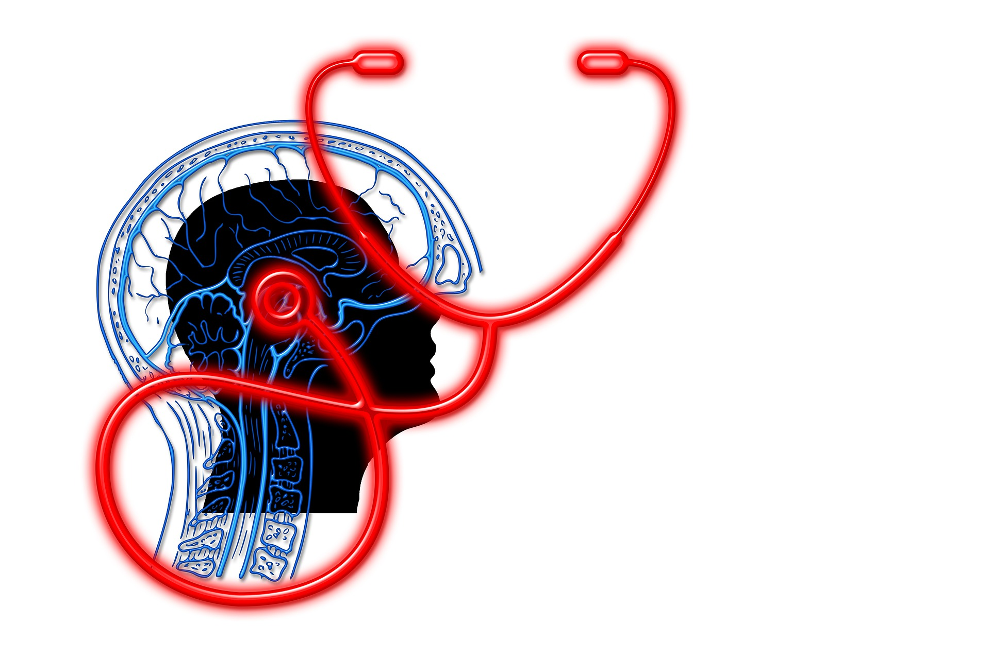
Is cognition important?
Should we be worried if our cognitive performance is limited?
Should we be worried if our cognitive performance is limited when we have a mental health condition?

Slide 6
Relevance of cognitive function and functional large-scale networks in mental health conditions
Psychotic disorders

Slide 7
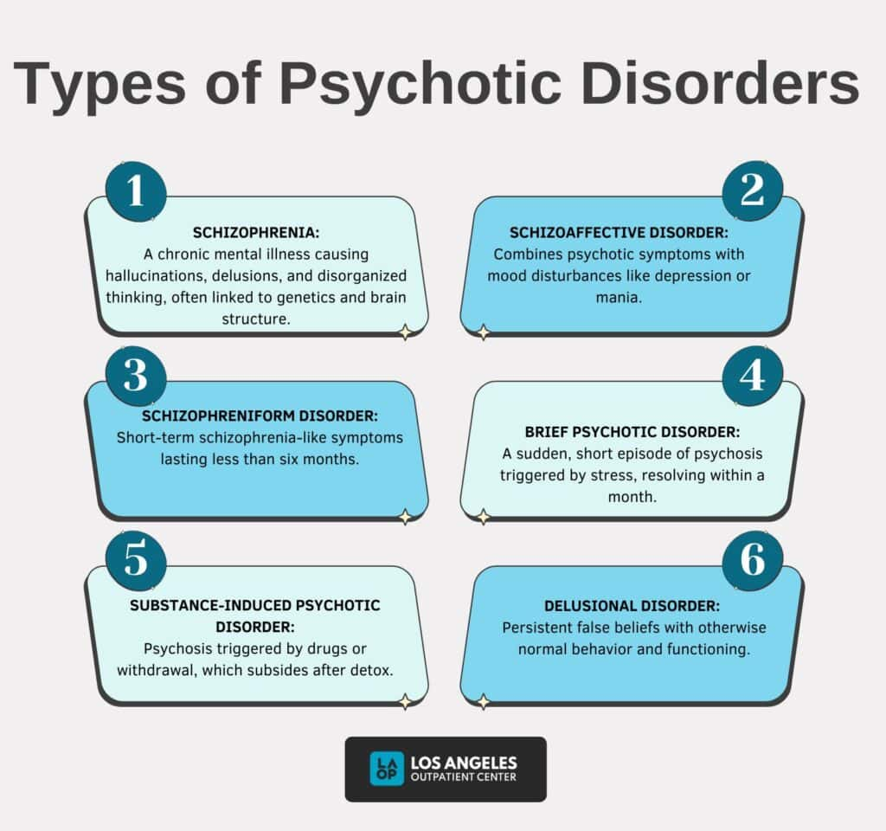
Los Angeles Outpatient Center Editorial Team, 2025

Slide 8
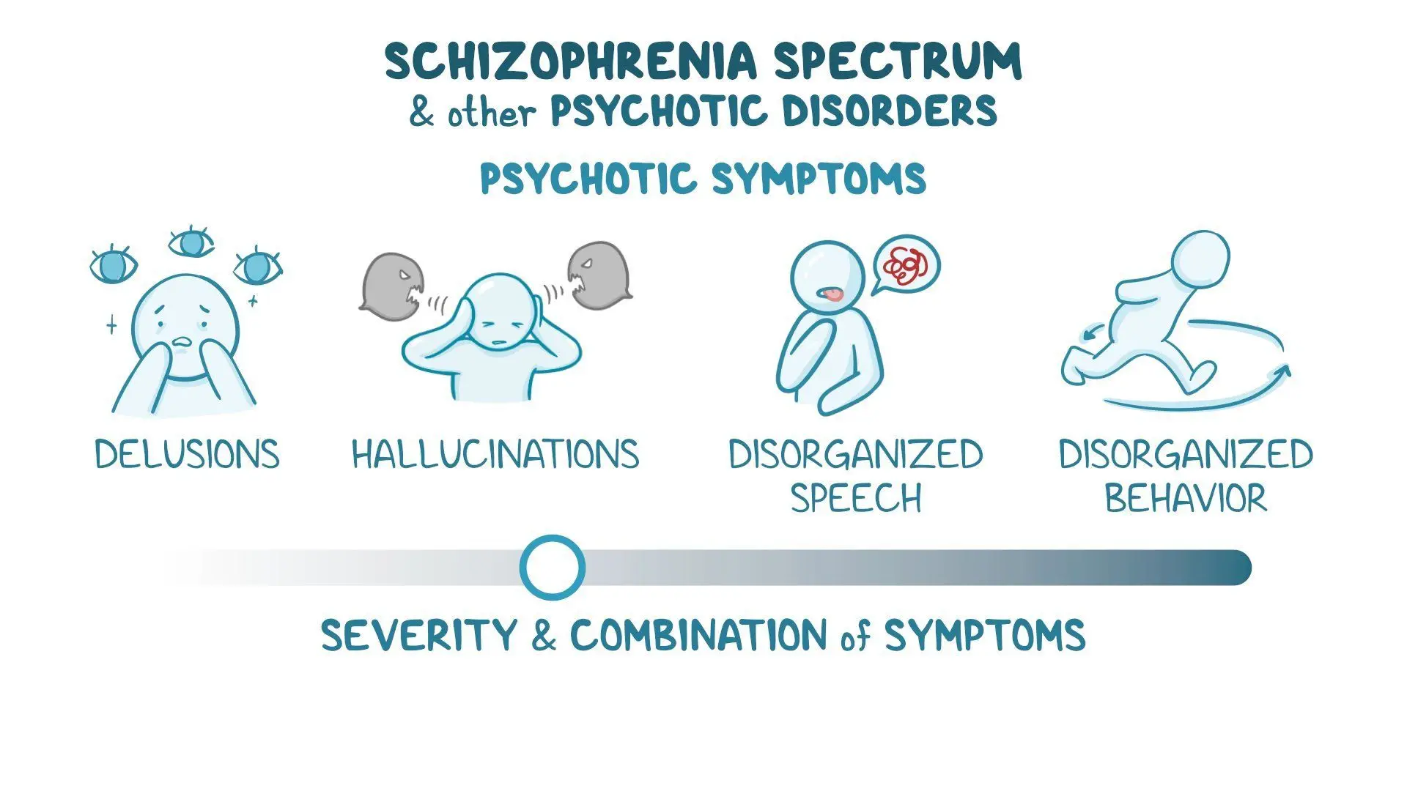
Psychotic disorders - Background
Prevalence and diagnosis
Approximately 0.5 - 1% or approximately 24 million people worldwide
Neurodevelopmental and neurobiological disorder
Onset typically during late adolescence or early adulthood
Onset tends to happen earlier among men than women
Ride et al. 2020
Boland R et al. 2021
American Psychiatric Association, 2022

Slide 9



Psychotic disorders - Background
Symptoms and diagnosis
Positive symptoms (i.e., hallucination, delusions)
Negative symptoms (i.e., alogia)
Cognitive deficits (i.e., verbal memory, working memory, emotion recognition)
Some individuals are at high risk and about 22% of these individuals will transition to a psychotic disorder.
Already prior to diagnosis, cognitive deficits can occur, which are also prevalent with illness progression and are associated social disability.
American Psychiatric Association, 2013
Ride et al. 2020

Slide 10
Psychotic disorders - Multifactorial Causes
Genetic factors
- Genetic risk
- Familial risk
Neurobiological factors
- Structural, functional and network alterations
- Microbiological changes
Environmental factors
- Childhood trauma
- Recent trauma
- Infections
- Migrations
Other factors
- Substance abuse
- Sleep deprivation
- Childbirth
Ride et al. 2020
American Psychiatric Association, 2022

Slide 11
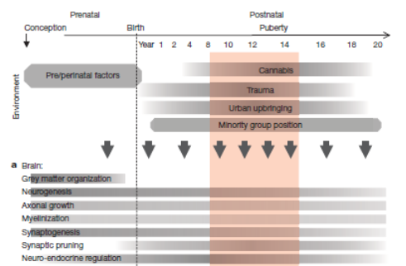
Environmental and biological risk factors in psychotic disorders
Approximate timing of the development of the human brain, functional abilities, and impact of environmental exposures
van Os et al. 2010

Slide 12
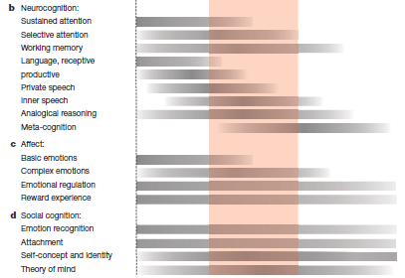
Impact on psychological and cognitive factors
Approximate timing of the development of the human brain, functional abilities, and impact of environmental exposures
van Os et al. 2010

Slide 13

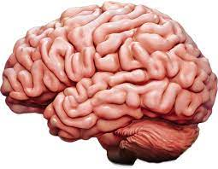
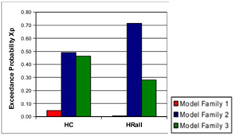
Characteristics of cognitive function/deficits between individuals in psychotic disorders
Clinical and
cognitive symptoms
Neurobiological markers
Functional networks
Clinical symptoms
Cognitive deficits
Lower surface area
Lower cortical thickness
Smaller volumes
Functional and effective connectivity

Slide 14

International Consortium for Health Outcomes Measurement
McKenzie et al. 2022

Slide 15
Theoretical basis of functional connectivity with examples

Slide 16
Functional Segregation
Specialised areas exist in the cortex
Functional Integration
Network(s) of interactions among specialised areas
Analyses of regionally specific effects
Identifies regions specialised for a particular task.
Univariate analysis
Analysis of how different regions in a neuronal system interact
Determines how experimental manipulation affects coupling between regions
Functional connectivity
Effective connectivity
Adapted from Gitelman, 2011

Slide 17
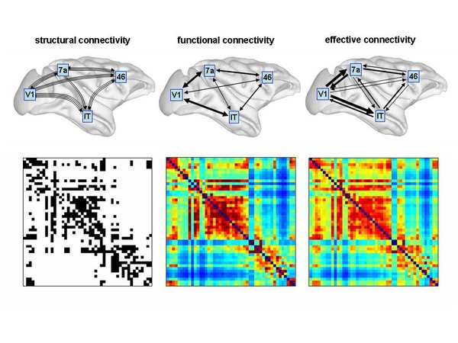
Functional neuroimaging with computational modelling
Statistical association or dependency between two or more anatomically distinct time-series
Structural (synaptic) connections linking sets of neurons or neuronal elements
Statistical association or dependency between two or more anatomically distinct time-series
Causal (directed) influences between neurones or neuronal populations
Sporns, 2007
Sporns, 2007

Slide 18
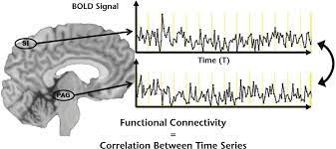
Functional connectivity
Definition: Statistical associations or dependencies between regional time series
Extraction of reference of time series
Voxel-wise correlation with time series from other voxels in the brain
Friston, 2003
Fox, 2005
Elliott, et al. 2017

Slide 19
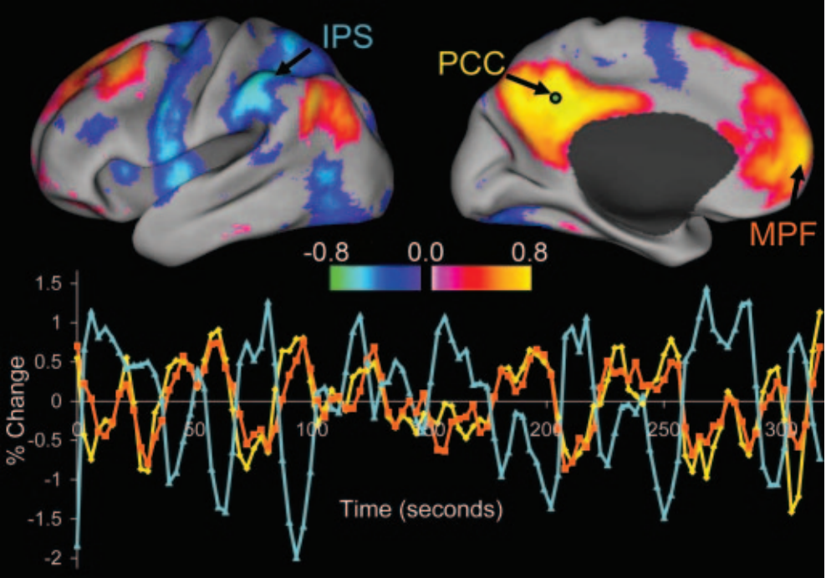
RSNs: Inhibitory relationships
Occurs during task and at rest
Resting-state networks
Correlation between spontaneous BOLD signals of brain regions known to be functionally and/or structurally related
Default mode network (DMN)
Decreased activity during cognitive tasks
Inversely related to regions activated by cognitive tasks
Task-positive and task-negative networks
Functional connectivity
Fox et al. 2007

Slide 20
Functional connectivity approaches
Model-dependent method - A priori or hypothesis-driven from previous literature
Model-free method – Data-driven method
Seed-based functional connectivity analysis
Coherence analysis (EEG)
Eigen-composition (i.e., Principal Component Analysis)
Independent Component Analysis

Slide 21
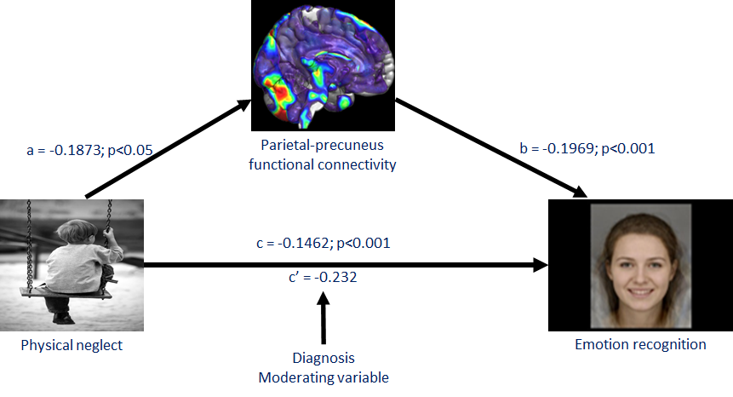
CHILDHOOD ADVERSITY AND RESTING-STATE FUNCTIONAL CONNECTIVITY
Dauvermann et al. 2021

Slide 22
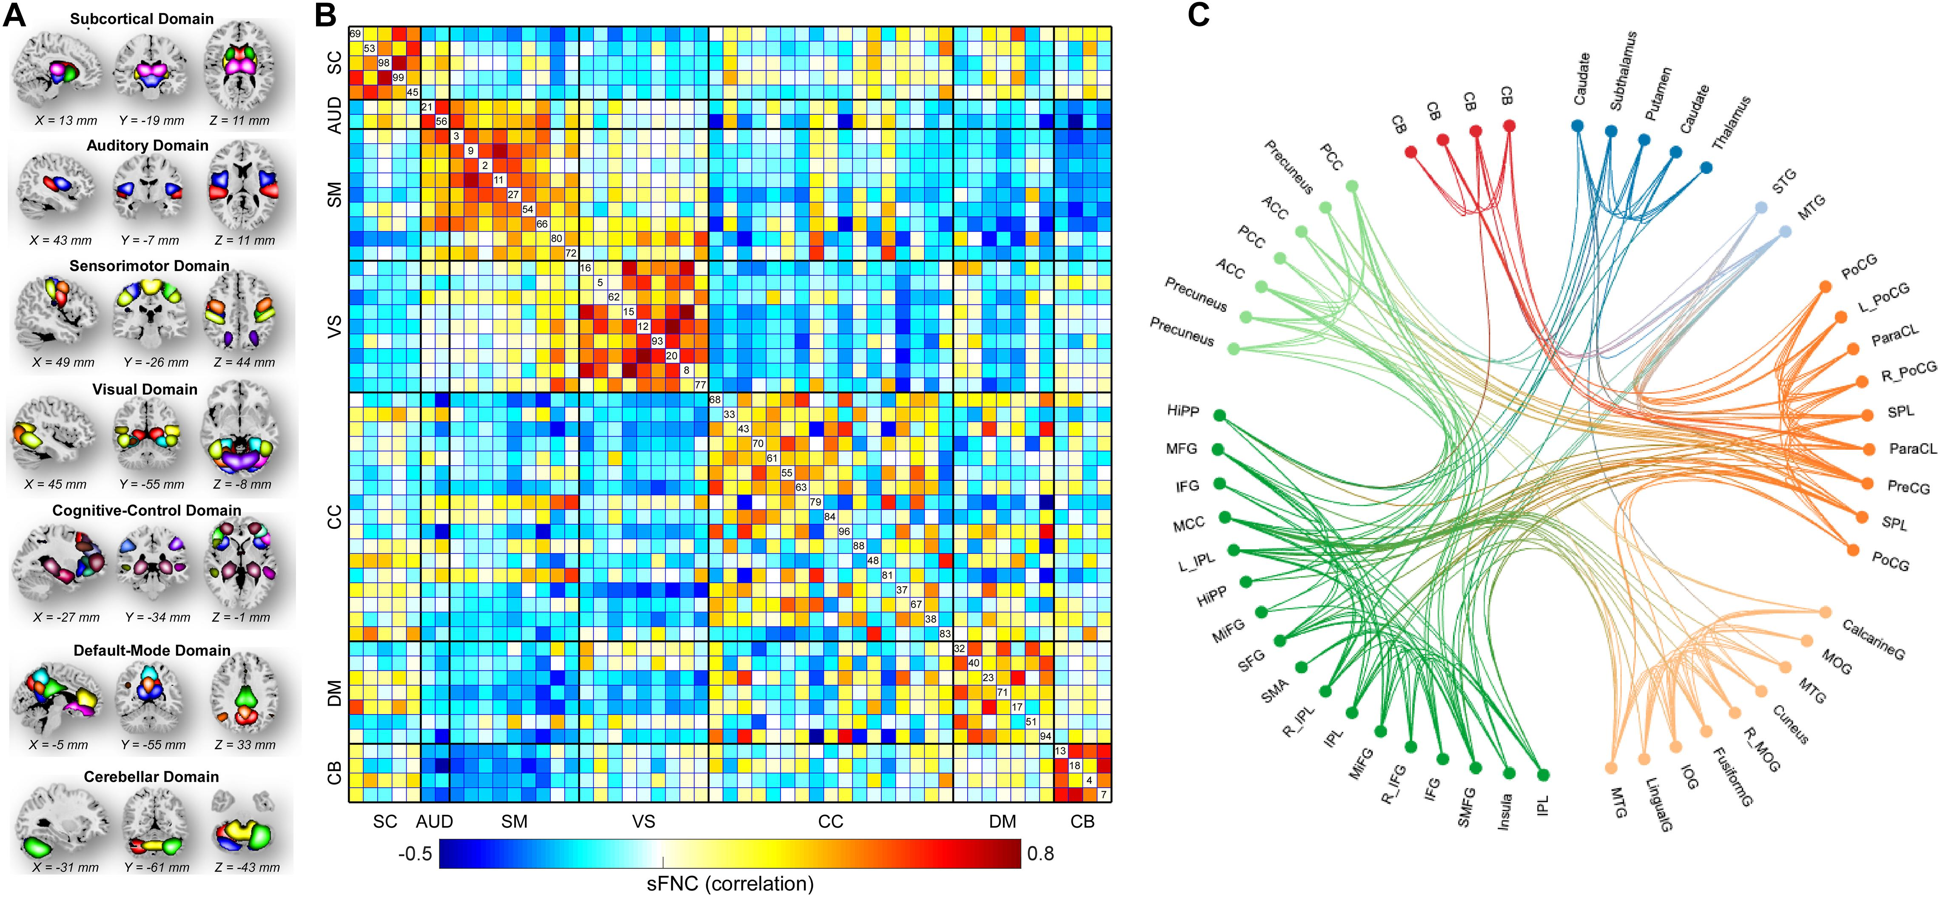
Functional connectivity (spatial maps) - EEG
Whole-Brain Functional Network Connectivity Abnormalities in Affective and Non-Affective Early Phase Psychosis
Fu et al. 2021

Slide 23
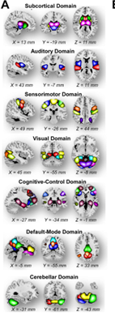
Spatial maps of the identified intrinsic connectivity networks (ICN) and spatial functional network connectivity 53 ICNs were identified and sorted into seven resting-state functional domains. Each colour represents a single intrinsic connectivity network
Fu et al. 2021

Slide 24
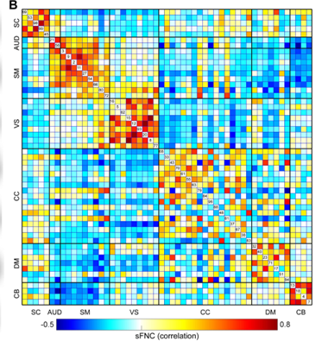
Spatial maps of the identified intrinsic connectivity networks and spatial functional network connectivity Averaged spatial functional network connectivity matrix across participants
Fu et al. 2021

Slide 25
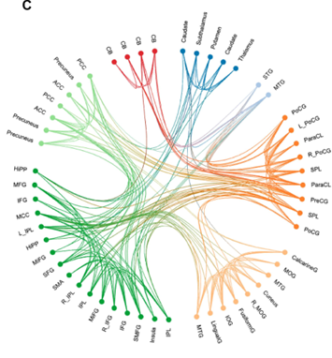
Spatial maps of the identified intrinsic connectivity networks and spatial functional network connectivity The functional connectivity profile of the averaged spatial functional network connectivity matrix.
Fu et al. 2021

Slide 26
Altered neural oscillations and synchrony in schizophrenia - MEG
Altered neural oscillations and their synchronisation may be core pathophysiological mechanisms in schizophrenia
Uhlhaas and Singer, 2010

Slide 27
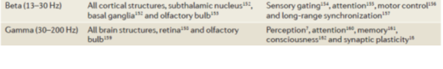
Altered neural oscillations and synchrony in schizophrenia - MEG
Associated with deficits in neural oscillations, especially in the beta- and gamma-band frequencies
Dysfunctions in neural synchrony could result from deficits in GABA (γ-aminobutyric acid)-ergic neurotransmission and the reduced integrity of cortico-cortical connections
Neural oscillations are involved in the maturation of cortical networks during early and late critical periods
Uhlhaas and Singer, 2010

Slide 28


Slide 29
Theoretical basis of effective connectivity with examples

Slide 30
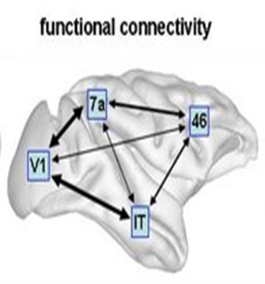
Functional connectivity
Advantages
Disadvantages
No experimental control (i.e., resting-state but also useful for tasks)
Free from experimental confounds
Possible to scan participants who would find it difficult to complete a task
No model of what caused the data (i.e., sleep or hallucinations)
Testing the 'baseline' hypothesis prior to experimental task
Complex networks
Interpretation of findings is based on correlations; descriptive
No mechanistic insight
Typically, dissatisfying for experimental tasks
Typically, suboptimal for experiments with a priori knowledge

Slide 31
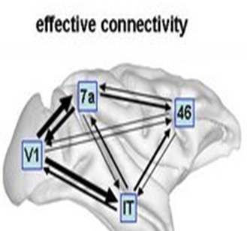
Effective connectivity
Definition: Causal (directed) influences between neurons or neuronal populations
Modelling causal interactions among neuronal populations with the aim of indirectly inferring on regional effects of inter-regional connectivity
Friston et al. 2003

Slide 32
Objectives for effective connectivity
Disadvantages from functional connectivity
Advantages to effective connectivity
Interpretation of findings is based on correlations; descriptive
No mechanistic insight
Typically, dissatisfying for experimental tasks
Typically, suboptimal for experiments with a priori knowledge
To analyse neural function on a network level
To infer neurobiological mechanisms underlying cognitive function
To infer causal or mechanistic function
To infer experimental modulation
To bridge the gap between rodent work and human work

Slide 33
Effective connectivity approaches
Structural Equation Modelling
(McIntosh et al., 1994; Büchel and Friston, 1997)
Regression models (Psychophysiological models)
(Friston et al., 1997)
Volterra kernels
(Friston et al., 2000) Time series models (Granger causality)
(Goebel et al., 2003)
Dynamic Causal Modelling (DCM)
(Friston et al., 2003; Stephan et al., 2008)

Slide 34
Dynamic Causal Modelling (DCM)

Slide 35
Basic Idea of DCM
Cognitive function is measured and modelled at the neural level.
The modelled neural dynamics (x) are transformed into area-specific BOLD signals (y) by a haemodynamic forward model (λ).
Aim: To estimate the parameters of a neural model, such that the predicted/modelled BOLD responses correspond as closely as possible to the observed/measured BOLD responses
BOLD
y
λ
Haemodynamic
model
x
Friston et al. 1993
Friston and Stephan, 2007

Slide 36
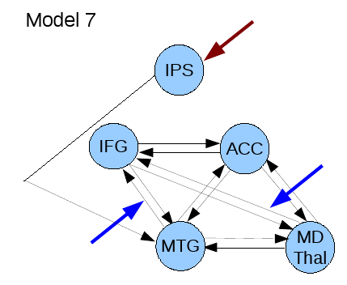
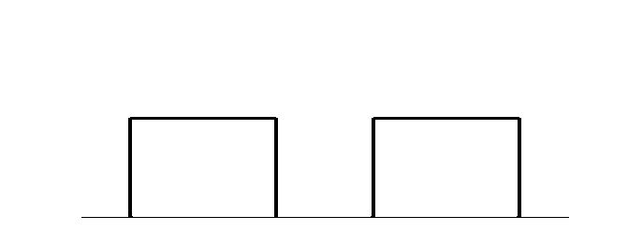
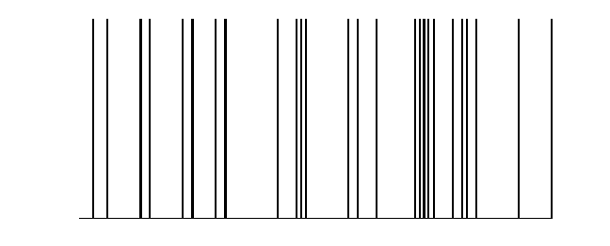
Activity-dependent changes of neural function
y
y
y
BOLD
y
λ
haemodynamic
model
activity
x₂(t)‏
activity
x₃(t)‏
activity
x₁(t)‏
neuronal
states
x
neuronal
states
Modulatory
input u₂(t)‏
integration
Modulatory
input u₂(t)‏
Neural state equation
Endogenous connectivity
Driving
input u₁(t)‏
Driving
input u₁(t)‏
t
Modulation of
connectivity
Direct inputs
Adapted from Friston et al. 1993
t
Stephan and Friston, 2007
t

Slide 37

Edinburgh High Risk Study (EHRS)
Familial risk of schizophrenia
At least two first-degree relatives with schizophrenia
Healthy controls
No family history of schizophrenia or personal history of a serious psychiatric disorder
Age between 16 and 25 years
HC Healthy controls
HR High risk subjects
HR- High risk subjects without symptoms
HR+ High risk subjects with symptoms
4 ill Four ill subjects with schizophrenia
Byrne et al. 1999
Johnstone et al. 2000

Slide 38
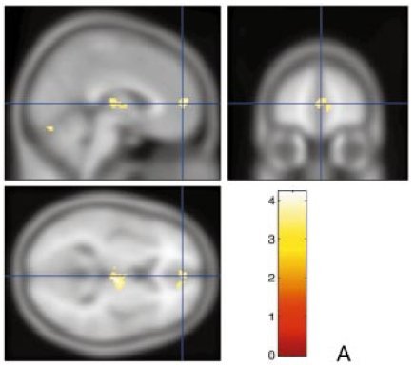

Verbal fluency task – Hayling Sentence Completion Task
Examples
‘He mailed the letter without a … .’ ‘Rushing out he forgot to take his … .’
Maps thresholded at P < 0.001 uncorrected voxel level, extent threshold 100 voxels.
Whalley et al. 2004
Notes:
38

Slide 39
Functional Connectivity
Left:
Reduced lateral-medial prefrontal FC in HR in contrast to HC
Right:
Reduced prefrontal-thalamic FC in HR in contrast to HC
HC Healthy controls
HR High risk subjects
HR- High risk subjects without symptoms
HR+ High risk subjects with symptoms
4 ill Four ill subjects with schizophrenia
Maps thresholded at T >=2.5, P<0.05 corrected for multiple comparison, minimum cluster size 50 voxels.
Whalley et al. 2005

Slide 40
Bayesian estimations of how the rate of change of neuronal activity in one region influences neuronal activity in other regions
Friston et al. 1993
Sporns, 2007
Notes:
40

Slide 41
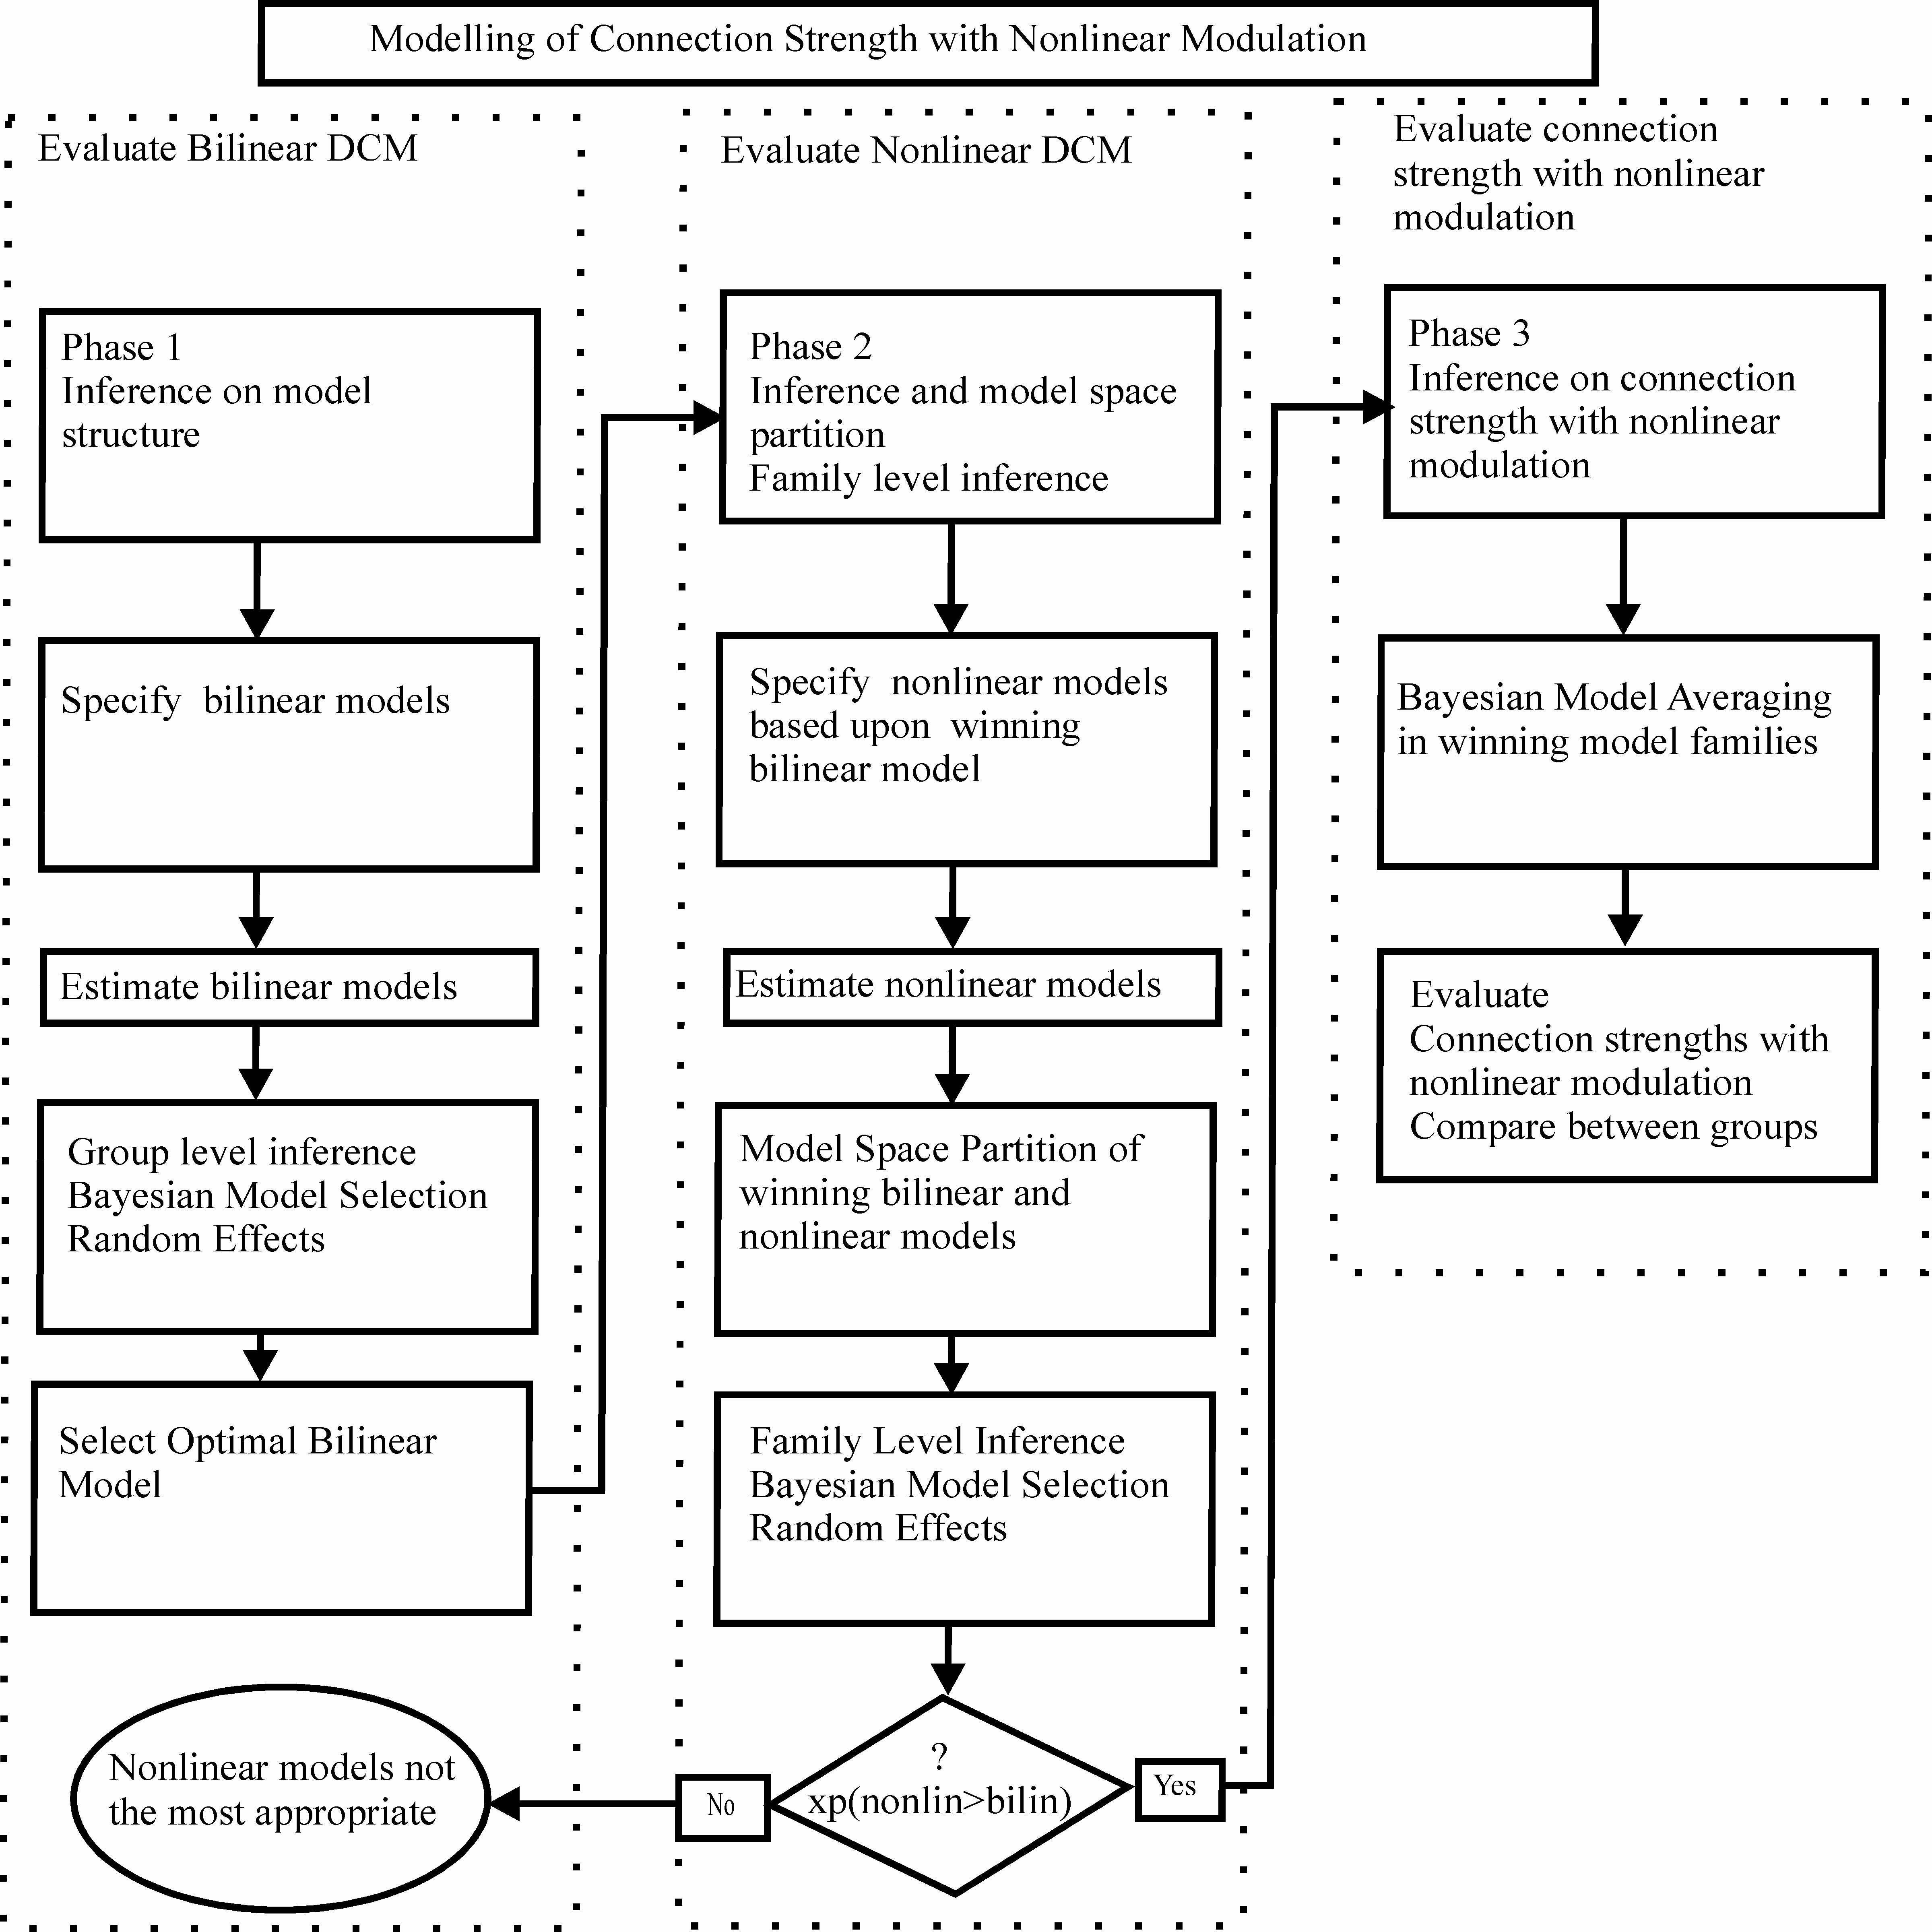
Dauvermann et al. 2013

Slide 42
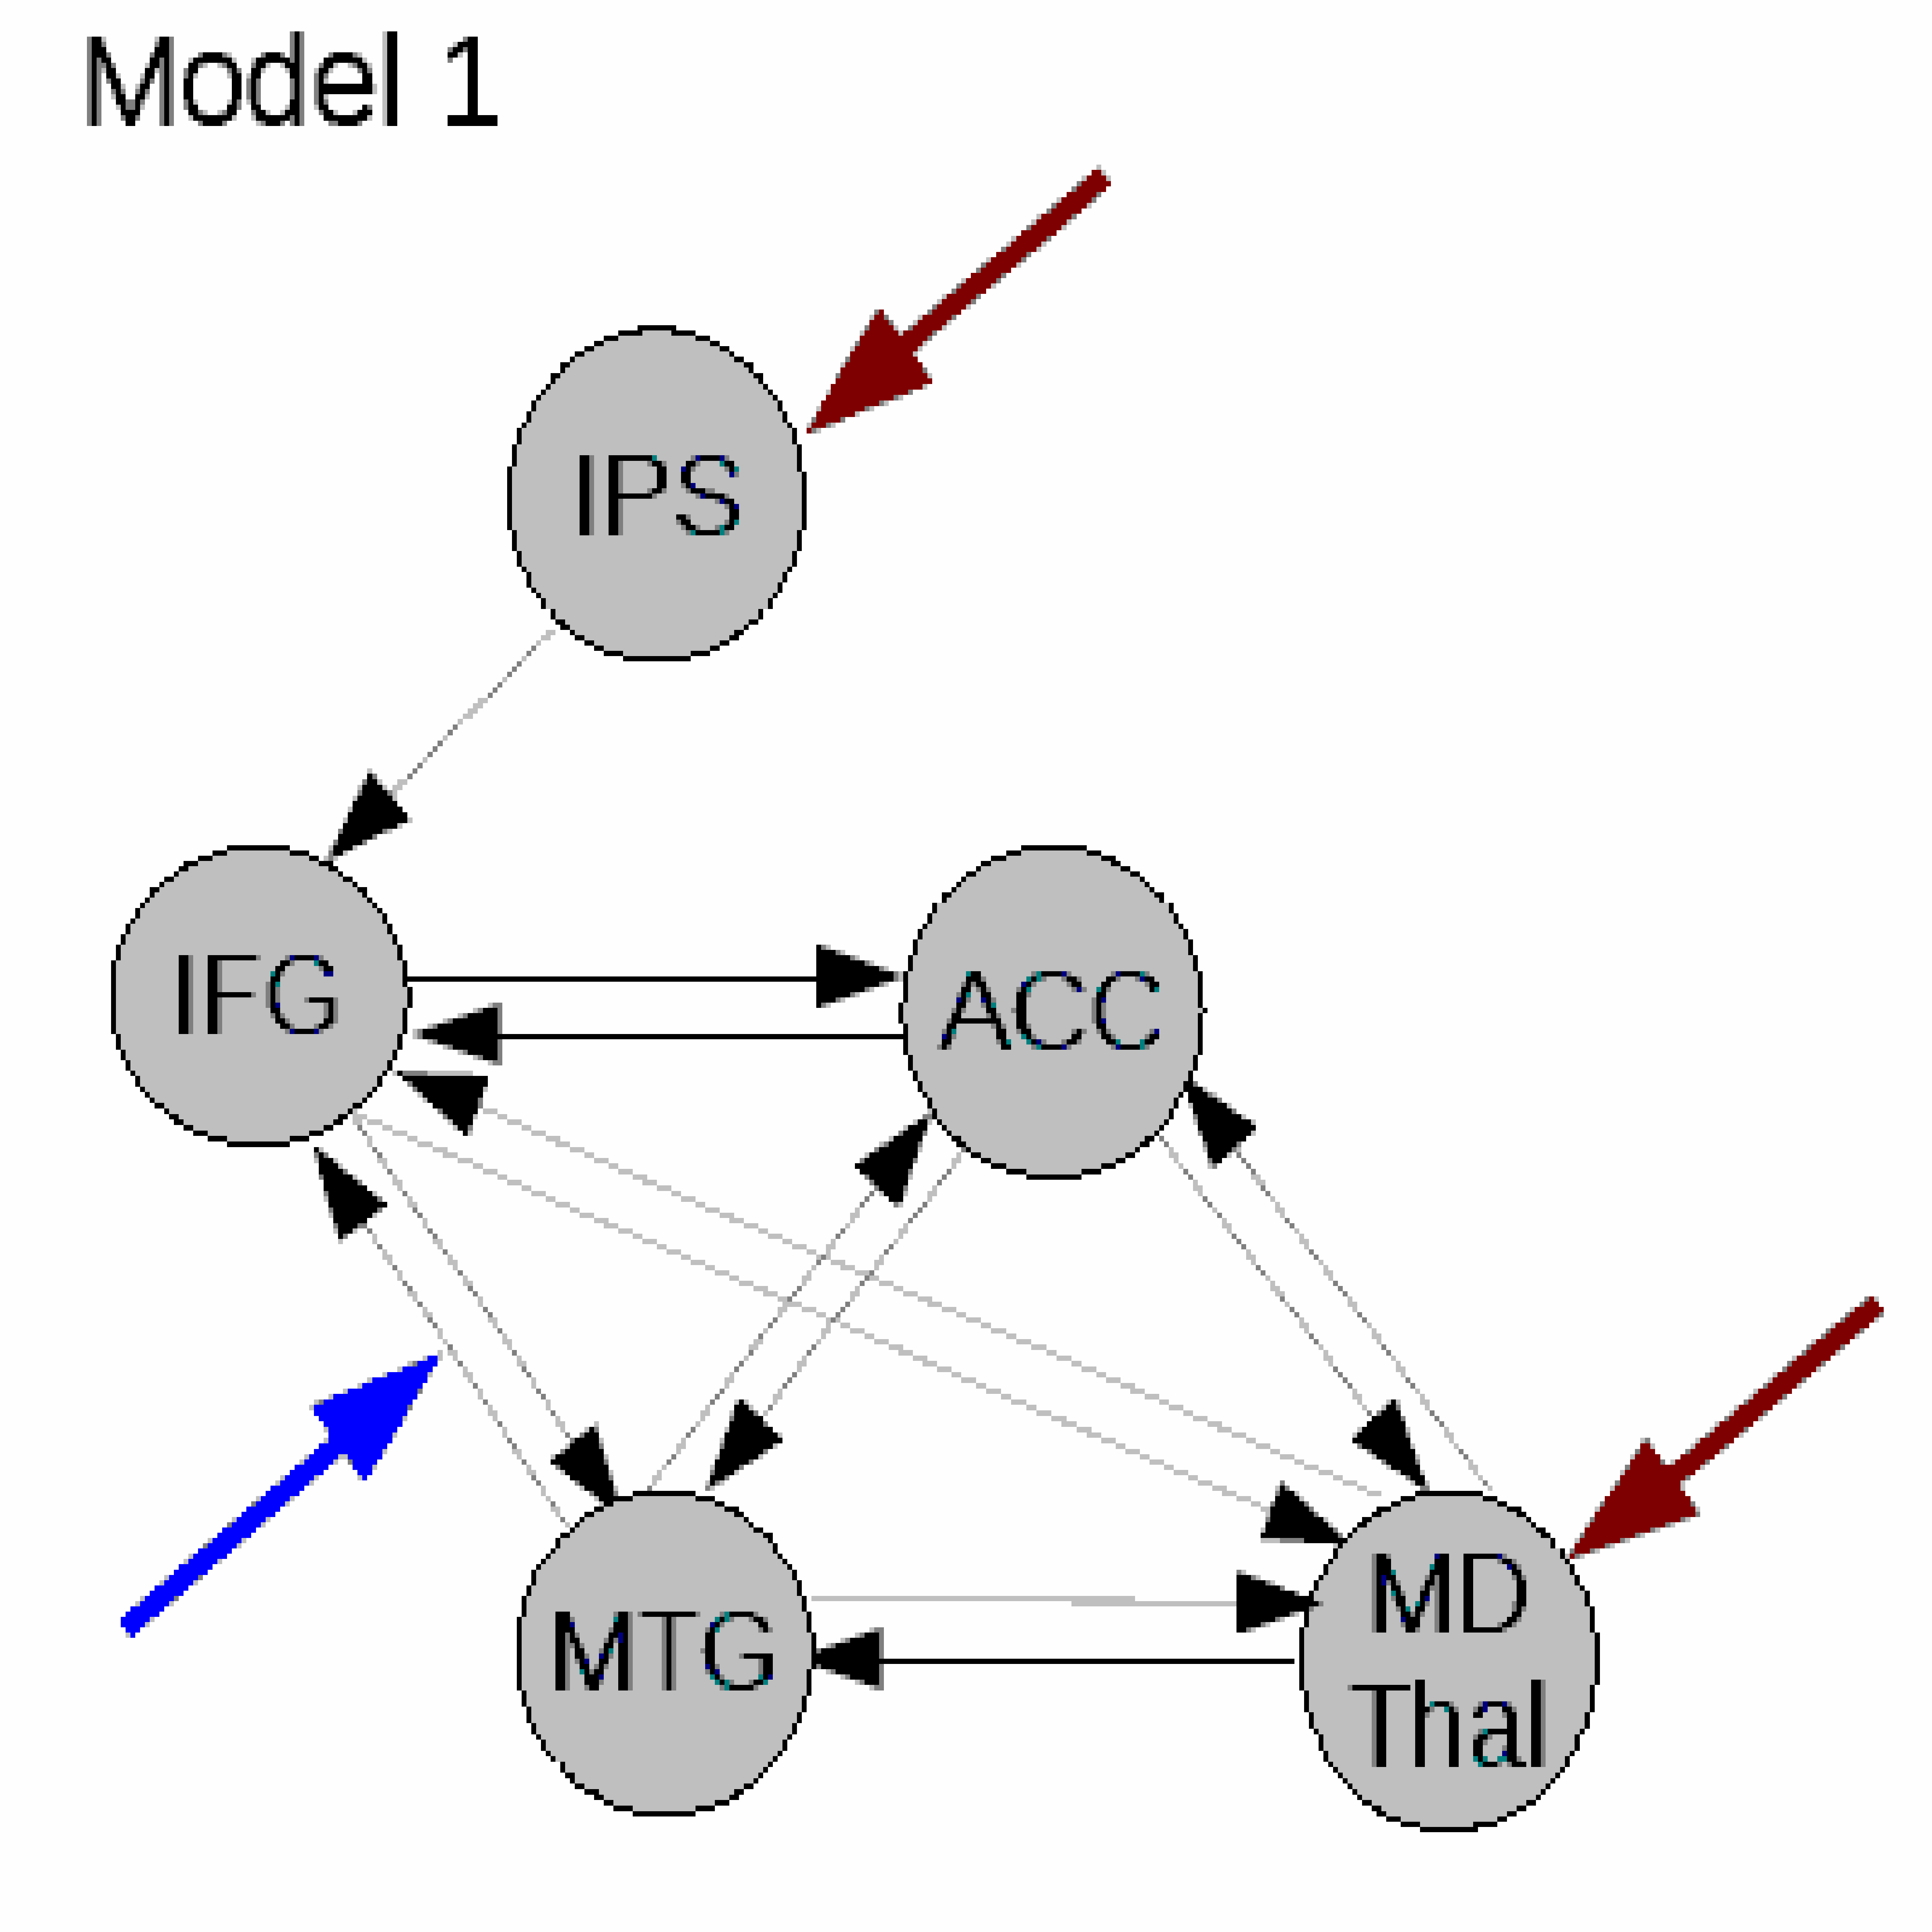
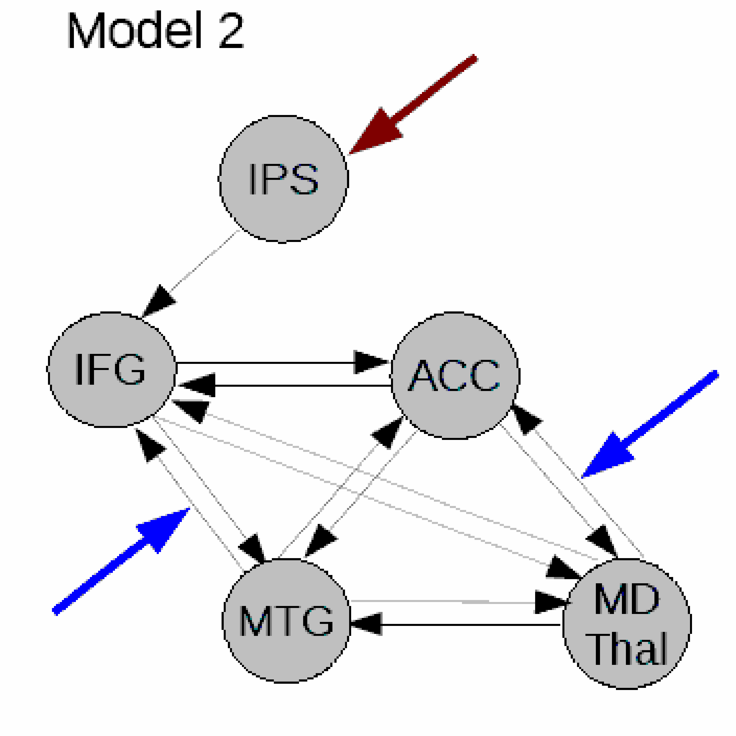
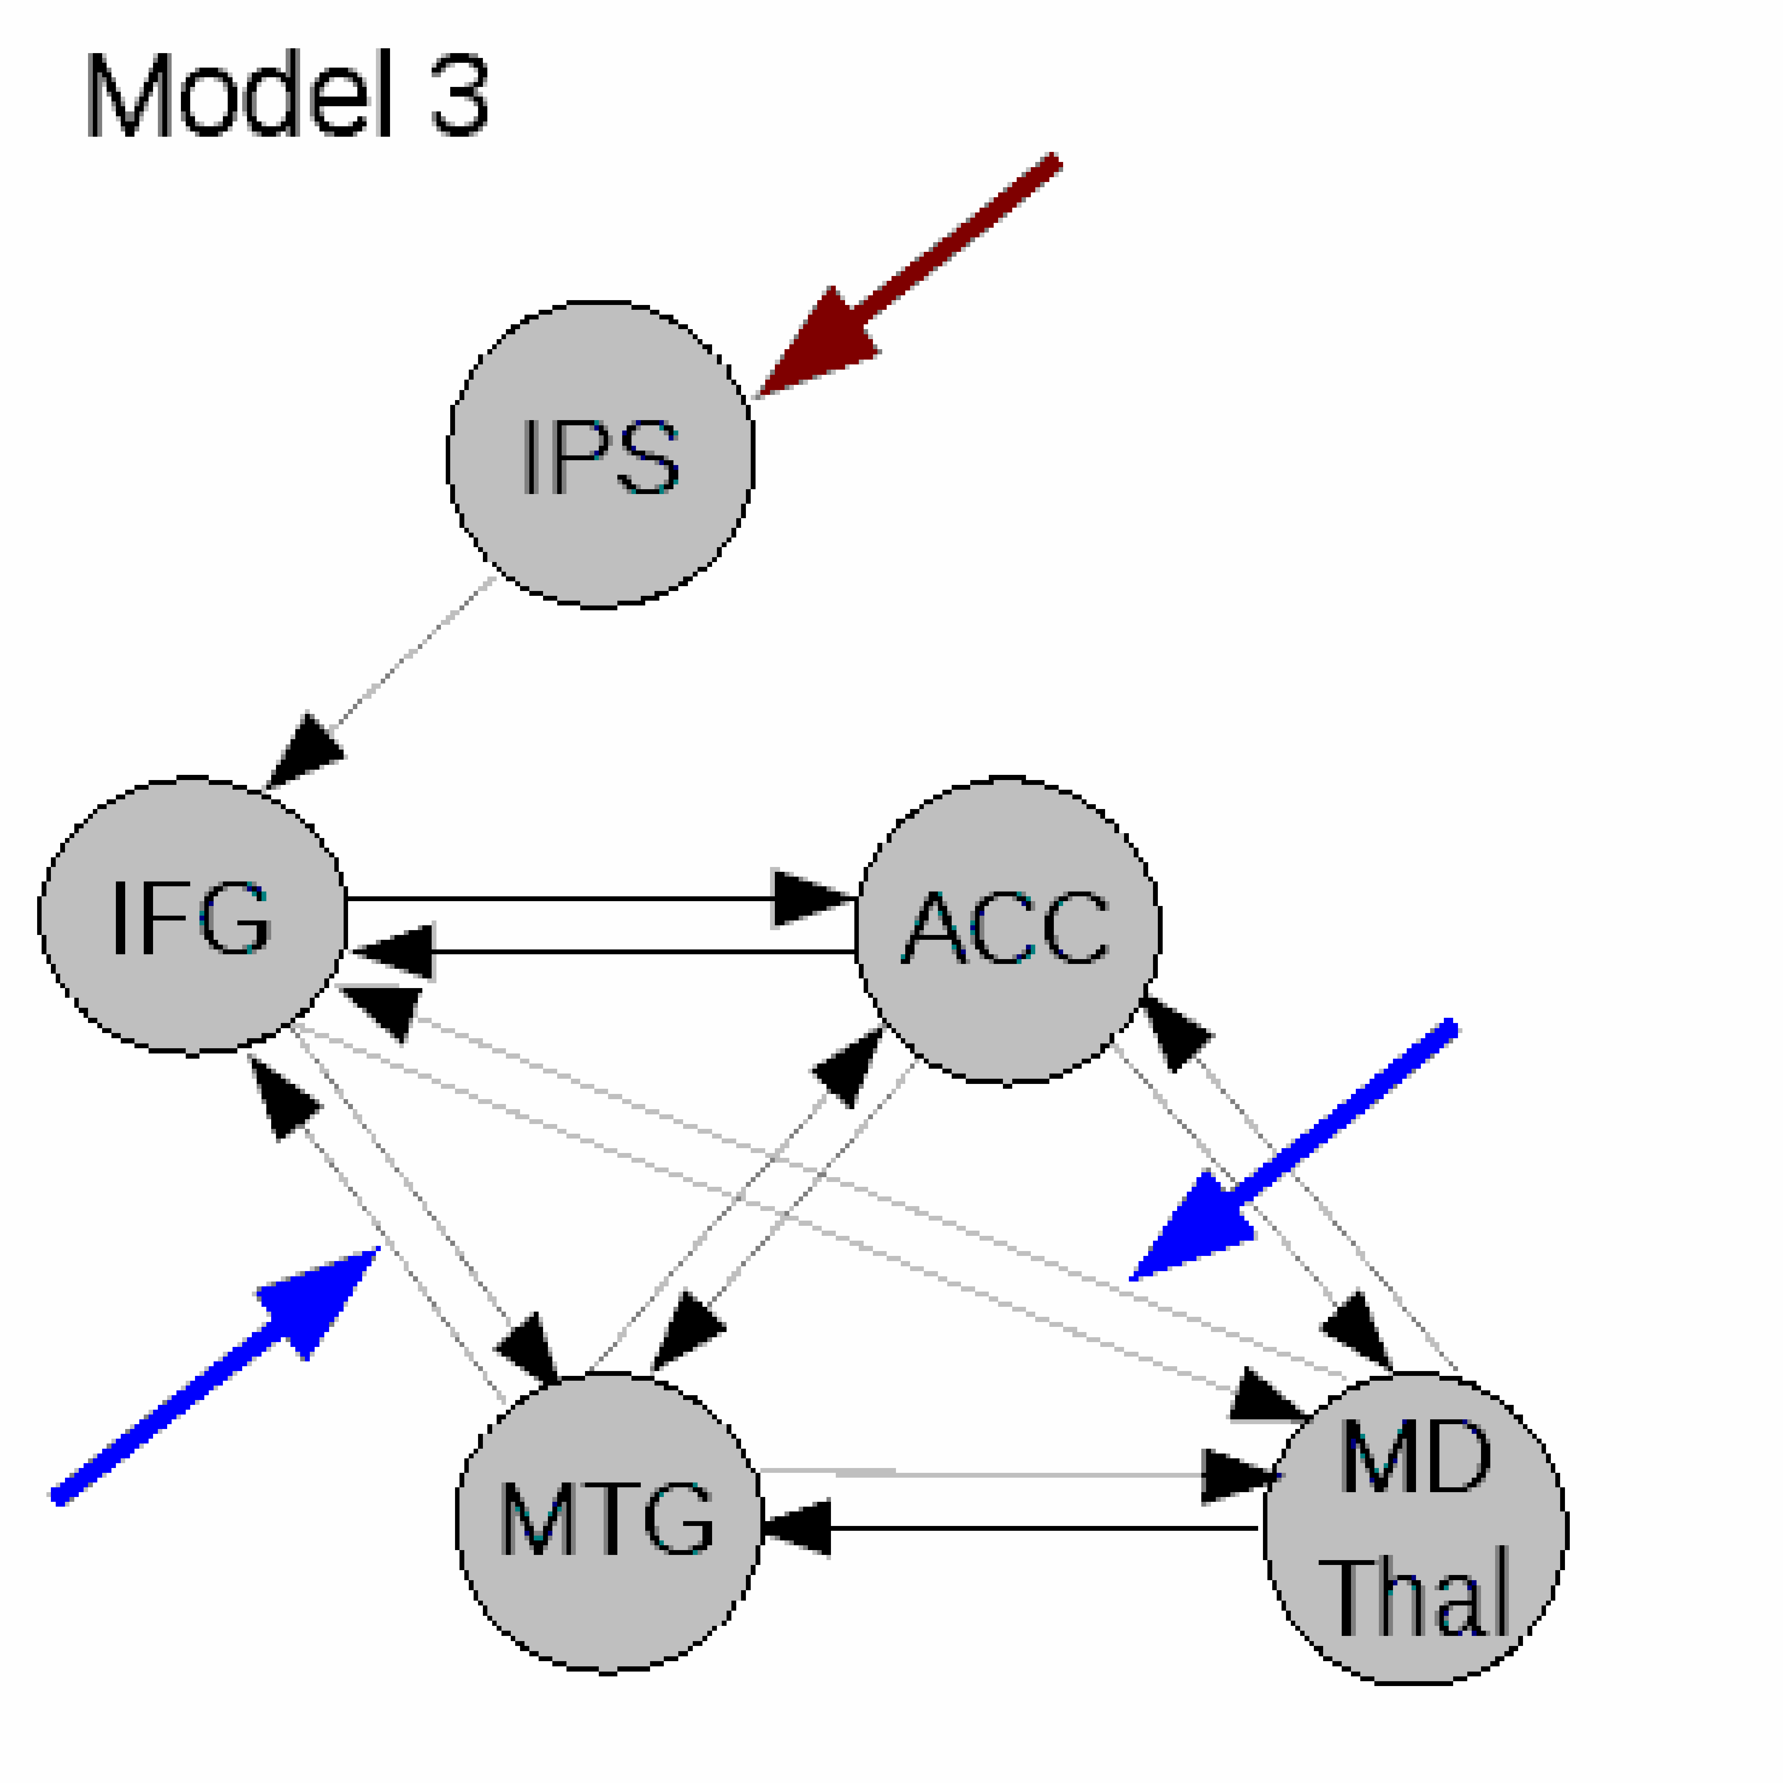
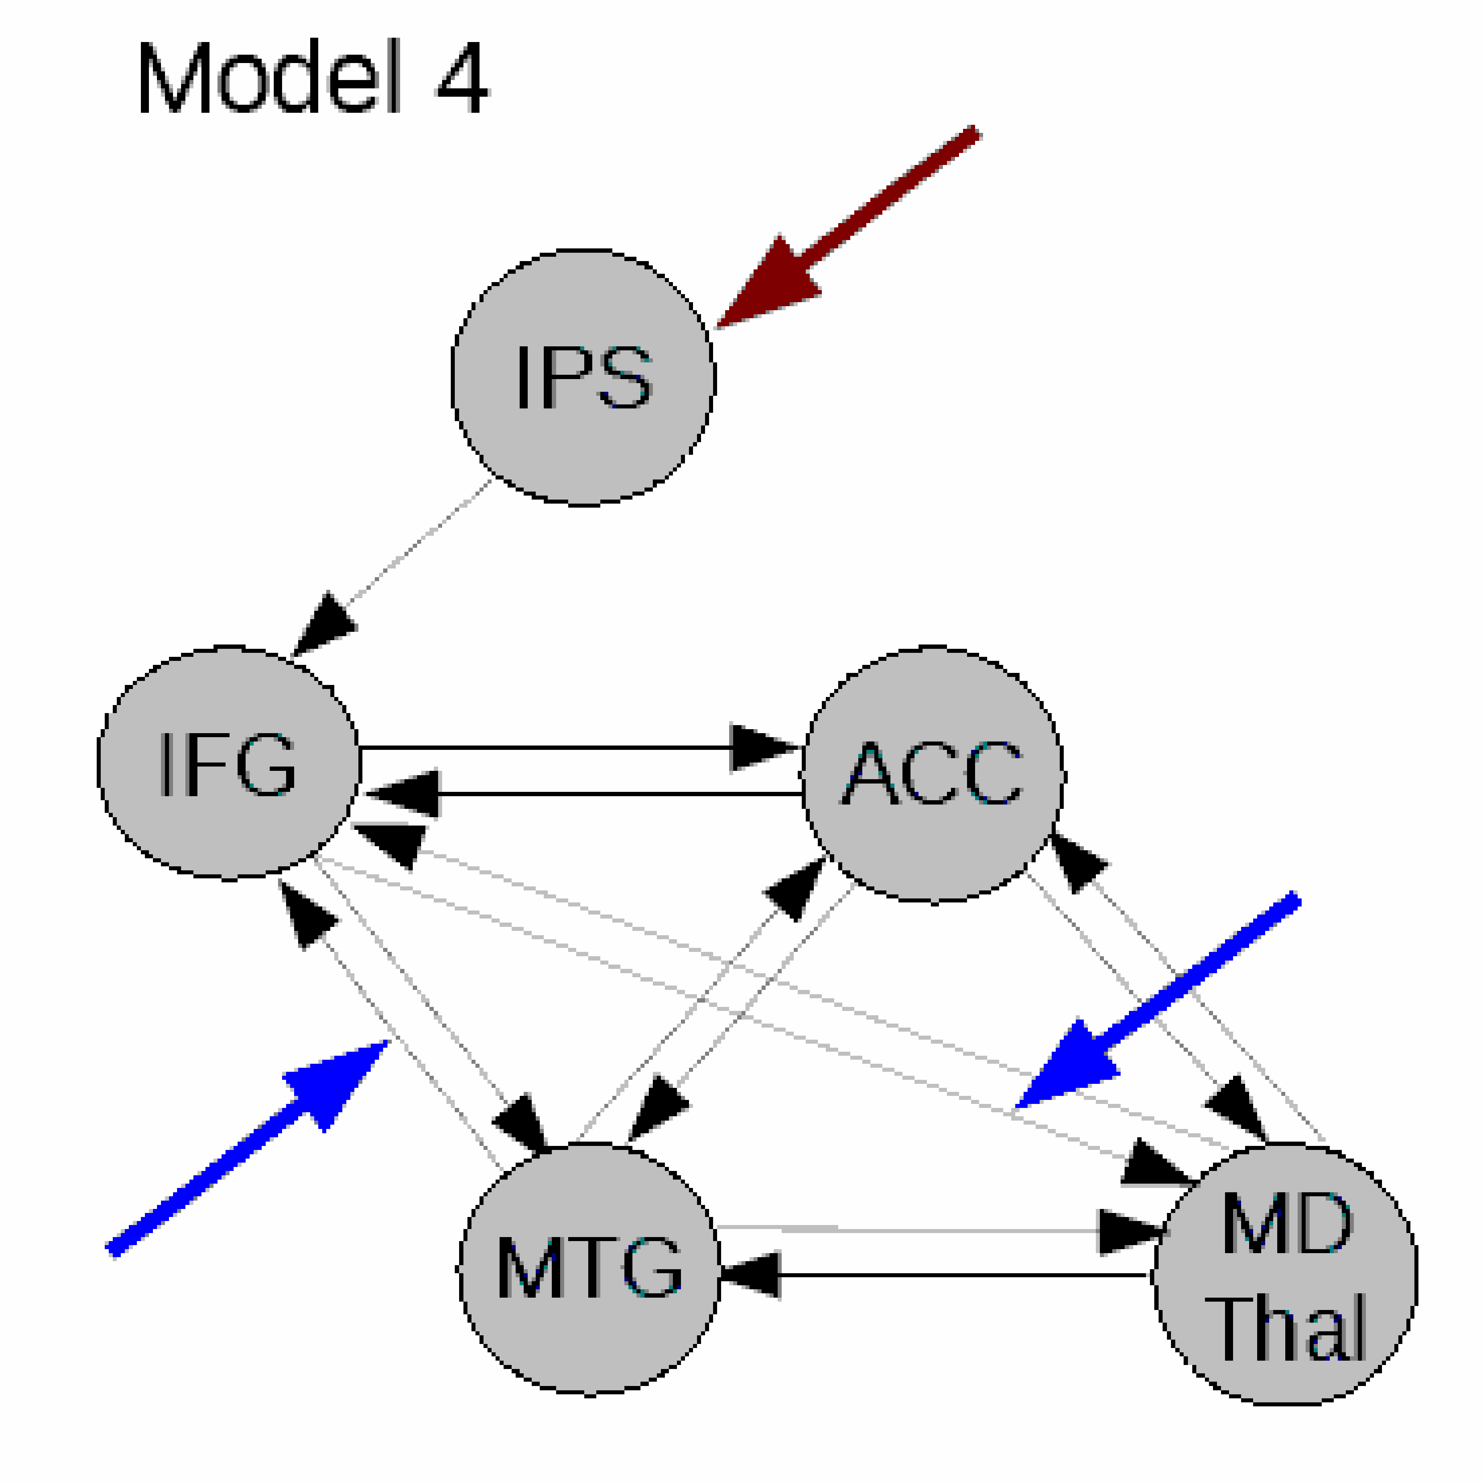
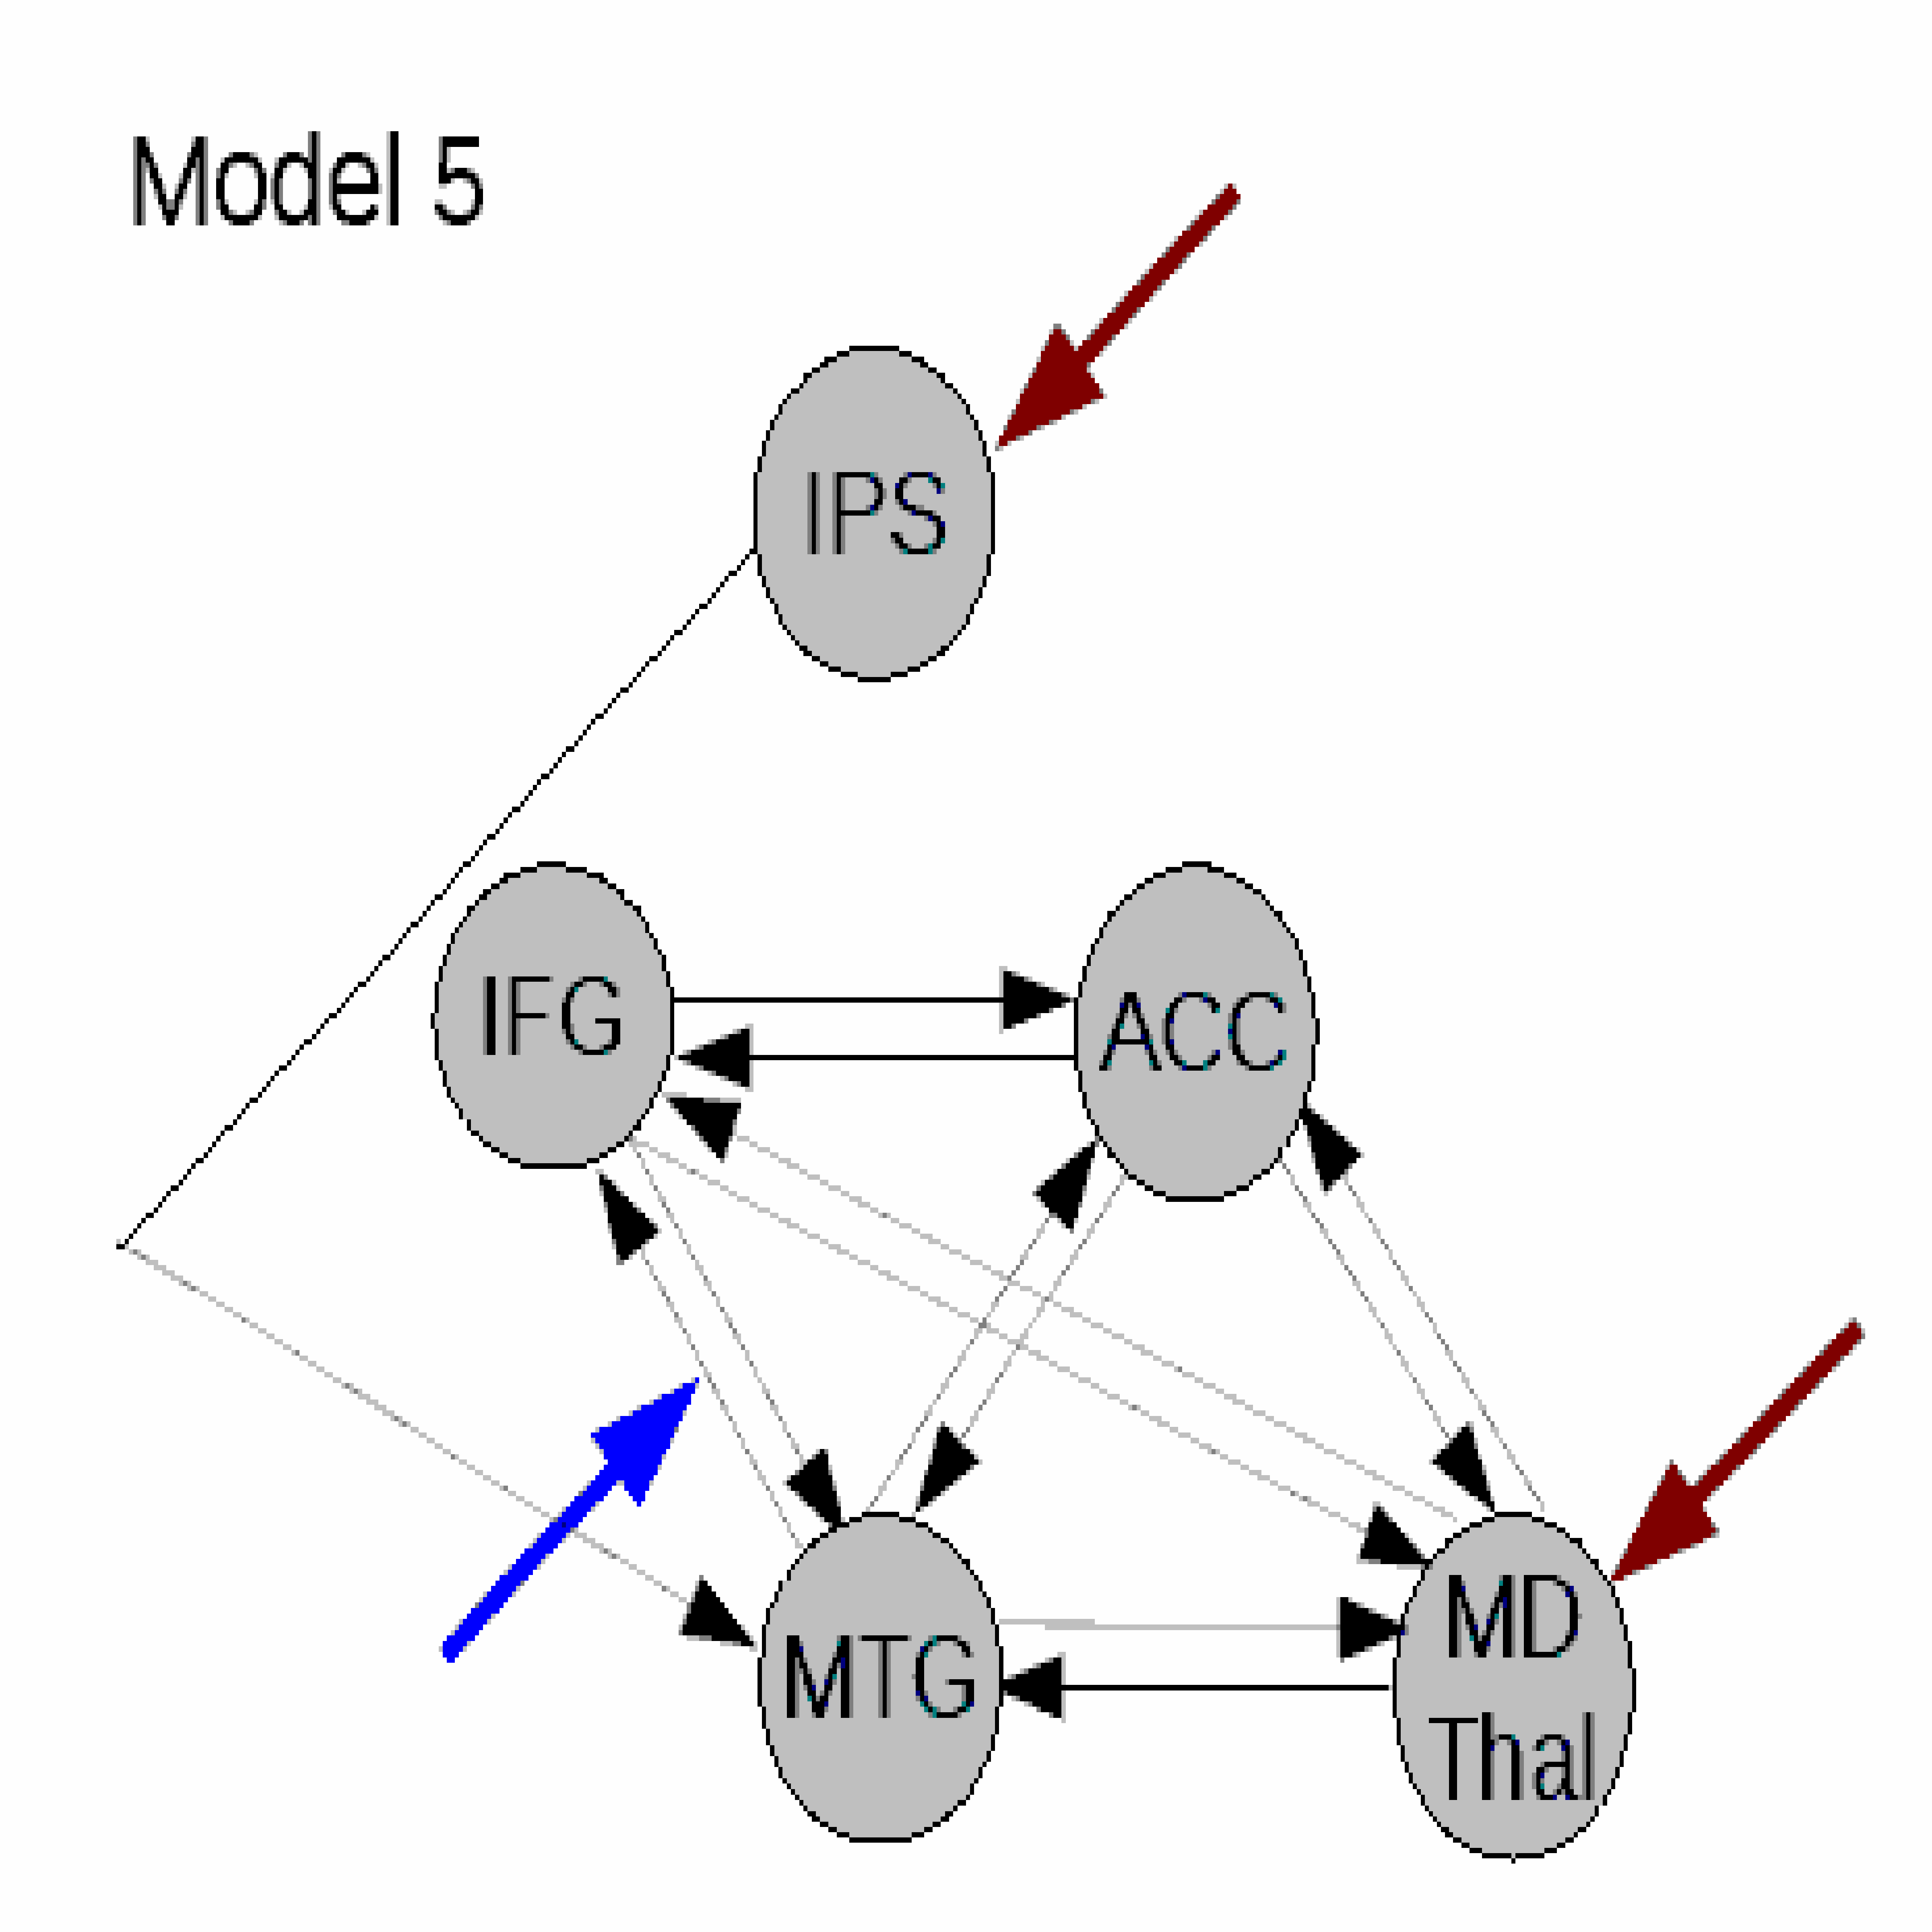
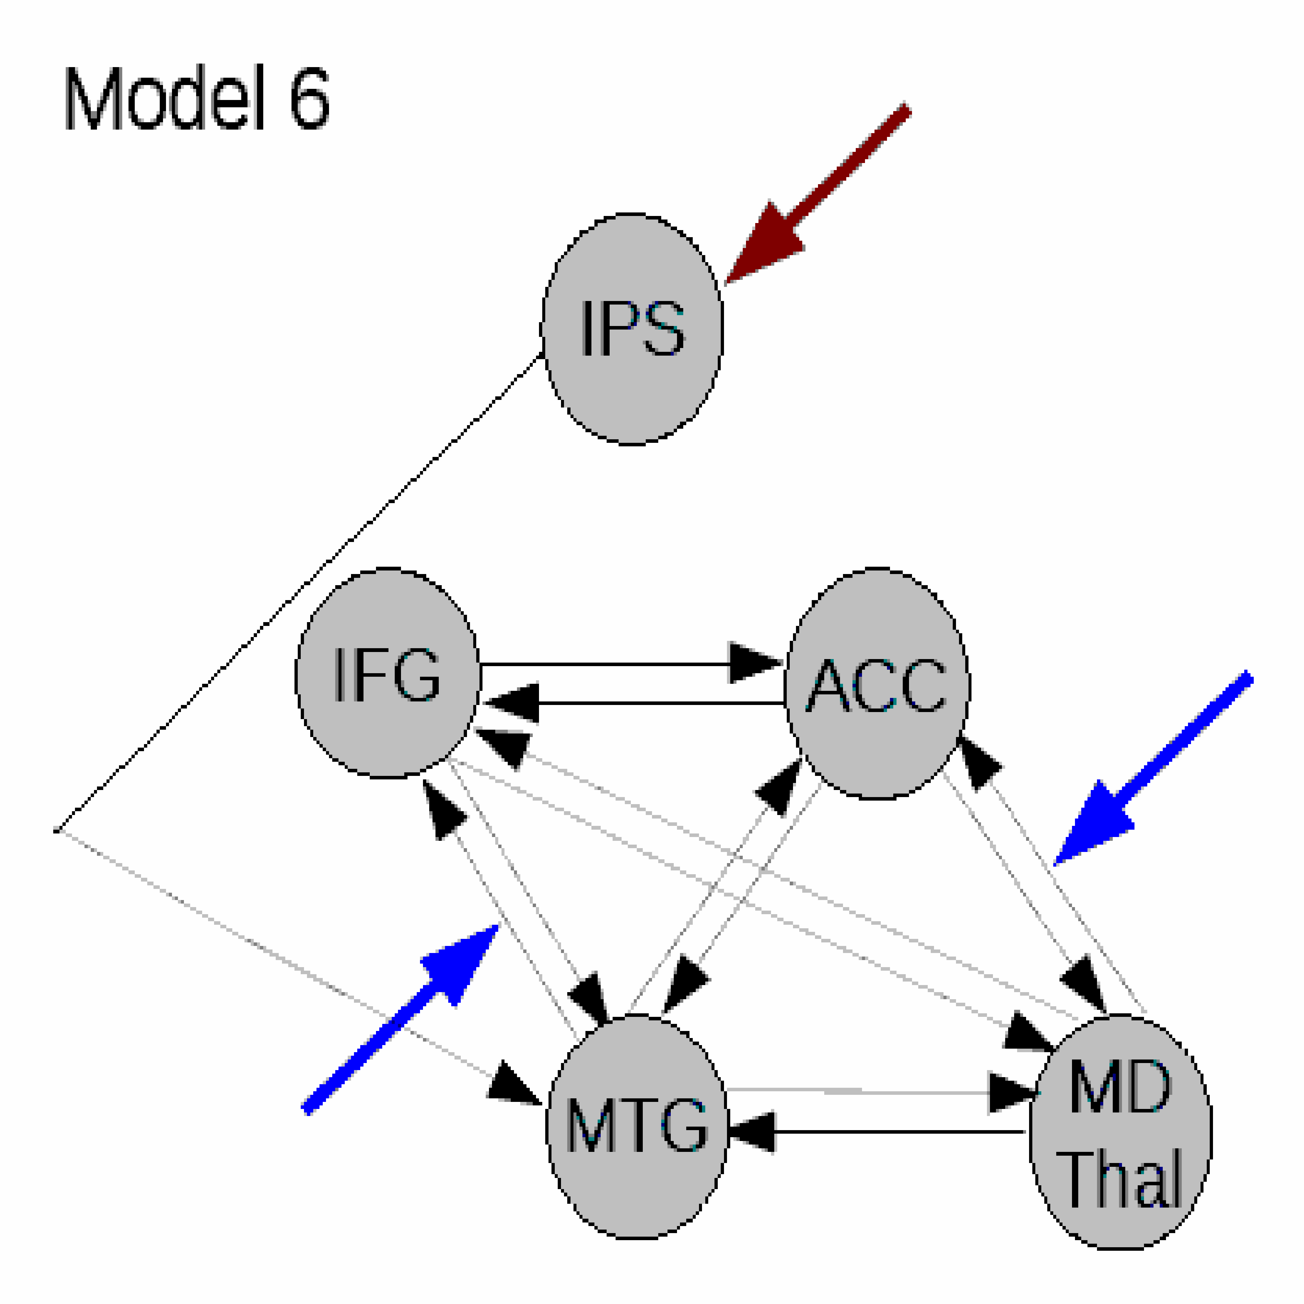
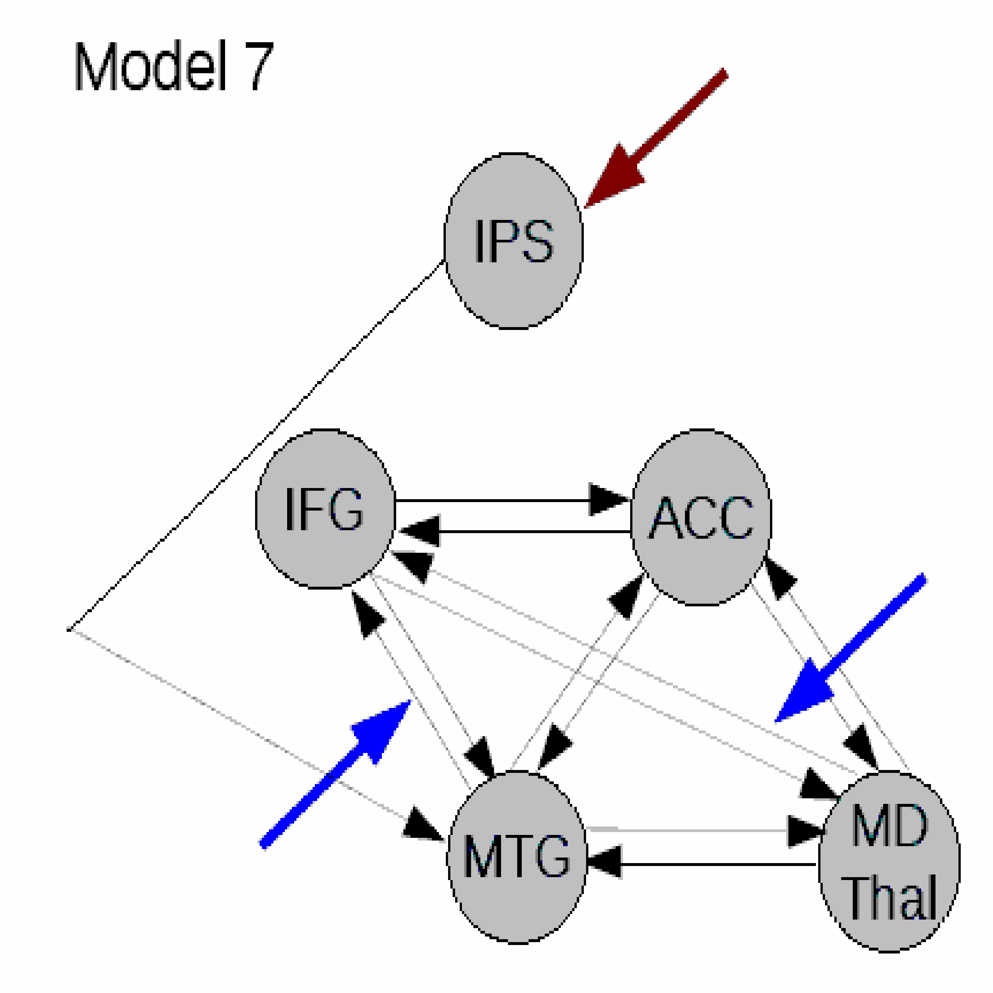
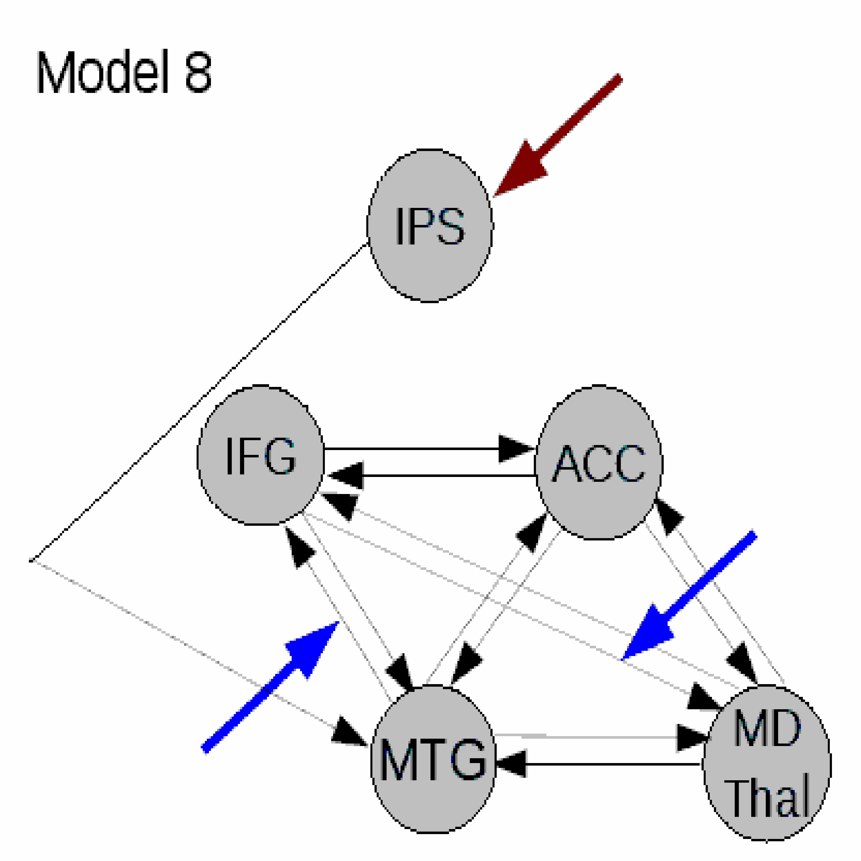
Linear Models
Endogenous connection
Modulatory input
Driving input
IPS Intra-parietal sulcus
IFG Inferior frontal gyrus
ACC Anterior cingulate cortex
MTG Middle temporal gyrus
MD Mediodorsal thalamus
Dauvermann et al. 2013

Slide 43
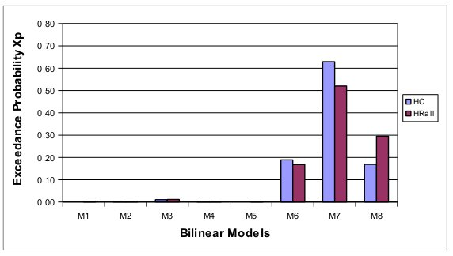
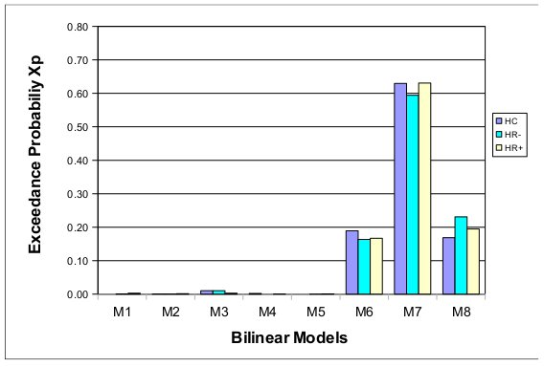
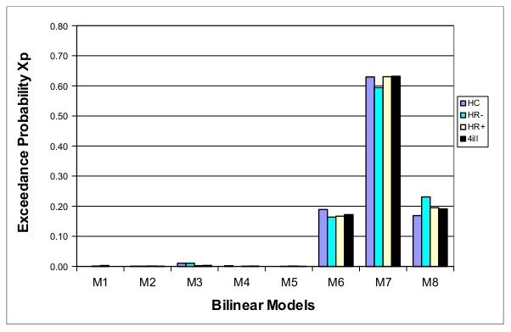
Optimal linear model
Dauvermann et al. 2013

Slide 44
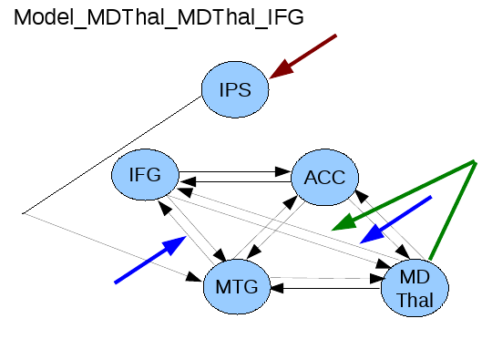
Activity-dependent changes of neural function
y
y
y
BOLD
y
λ
haemodynamic
model
activity
x₂(t)‏
activity
x₃(t)‏
activity
x₁(t)‏
neuronal
states
x
Modulatory
input u₂(t)‏
integration
Neural state equation
Endogenous connectivity
Driving
input u₁(t)‏
t
Modulation of
connectivity
Direct inputs
Nonlinear input
t
Stephan et al. 2008
Adapted from Friston et al. 1993

Slide 45
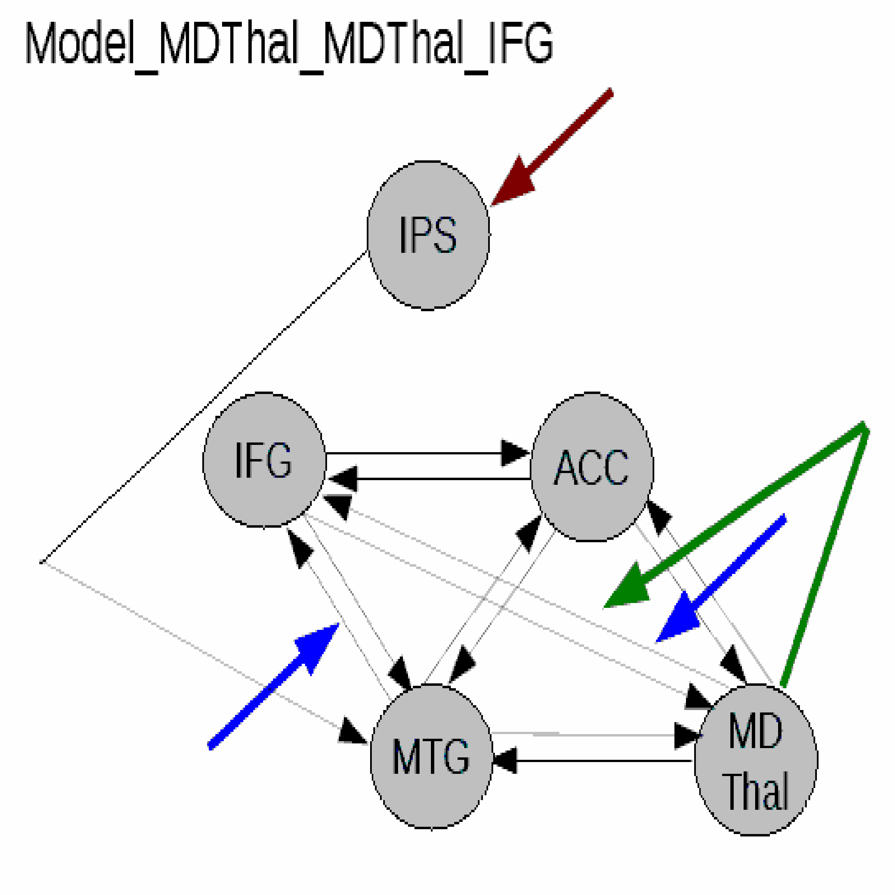
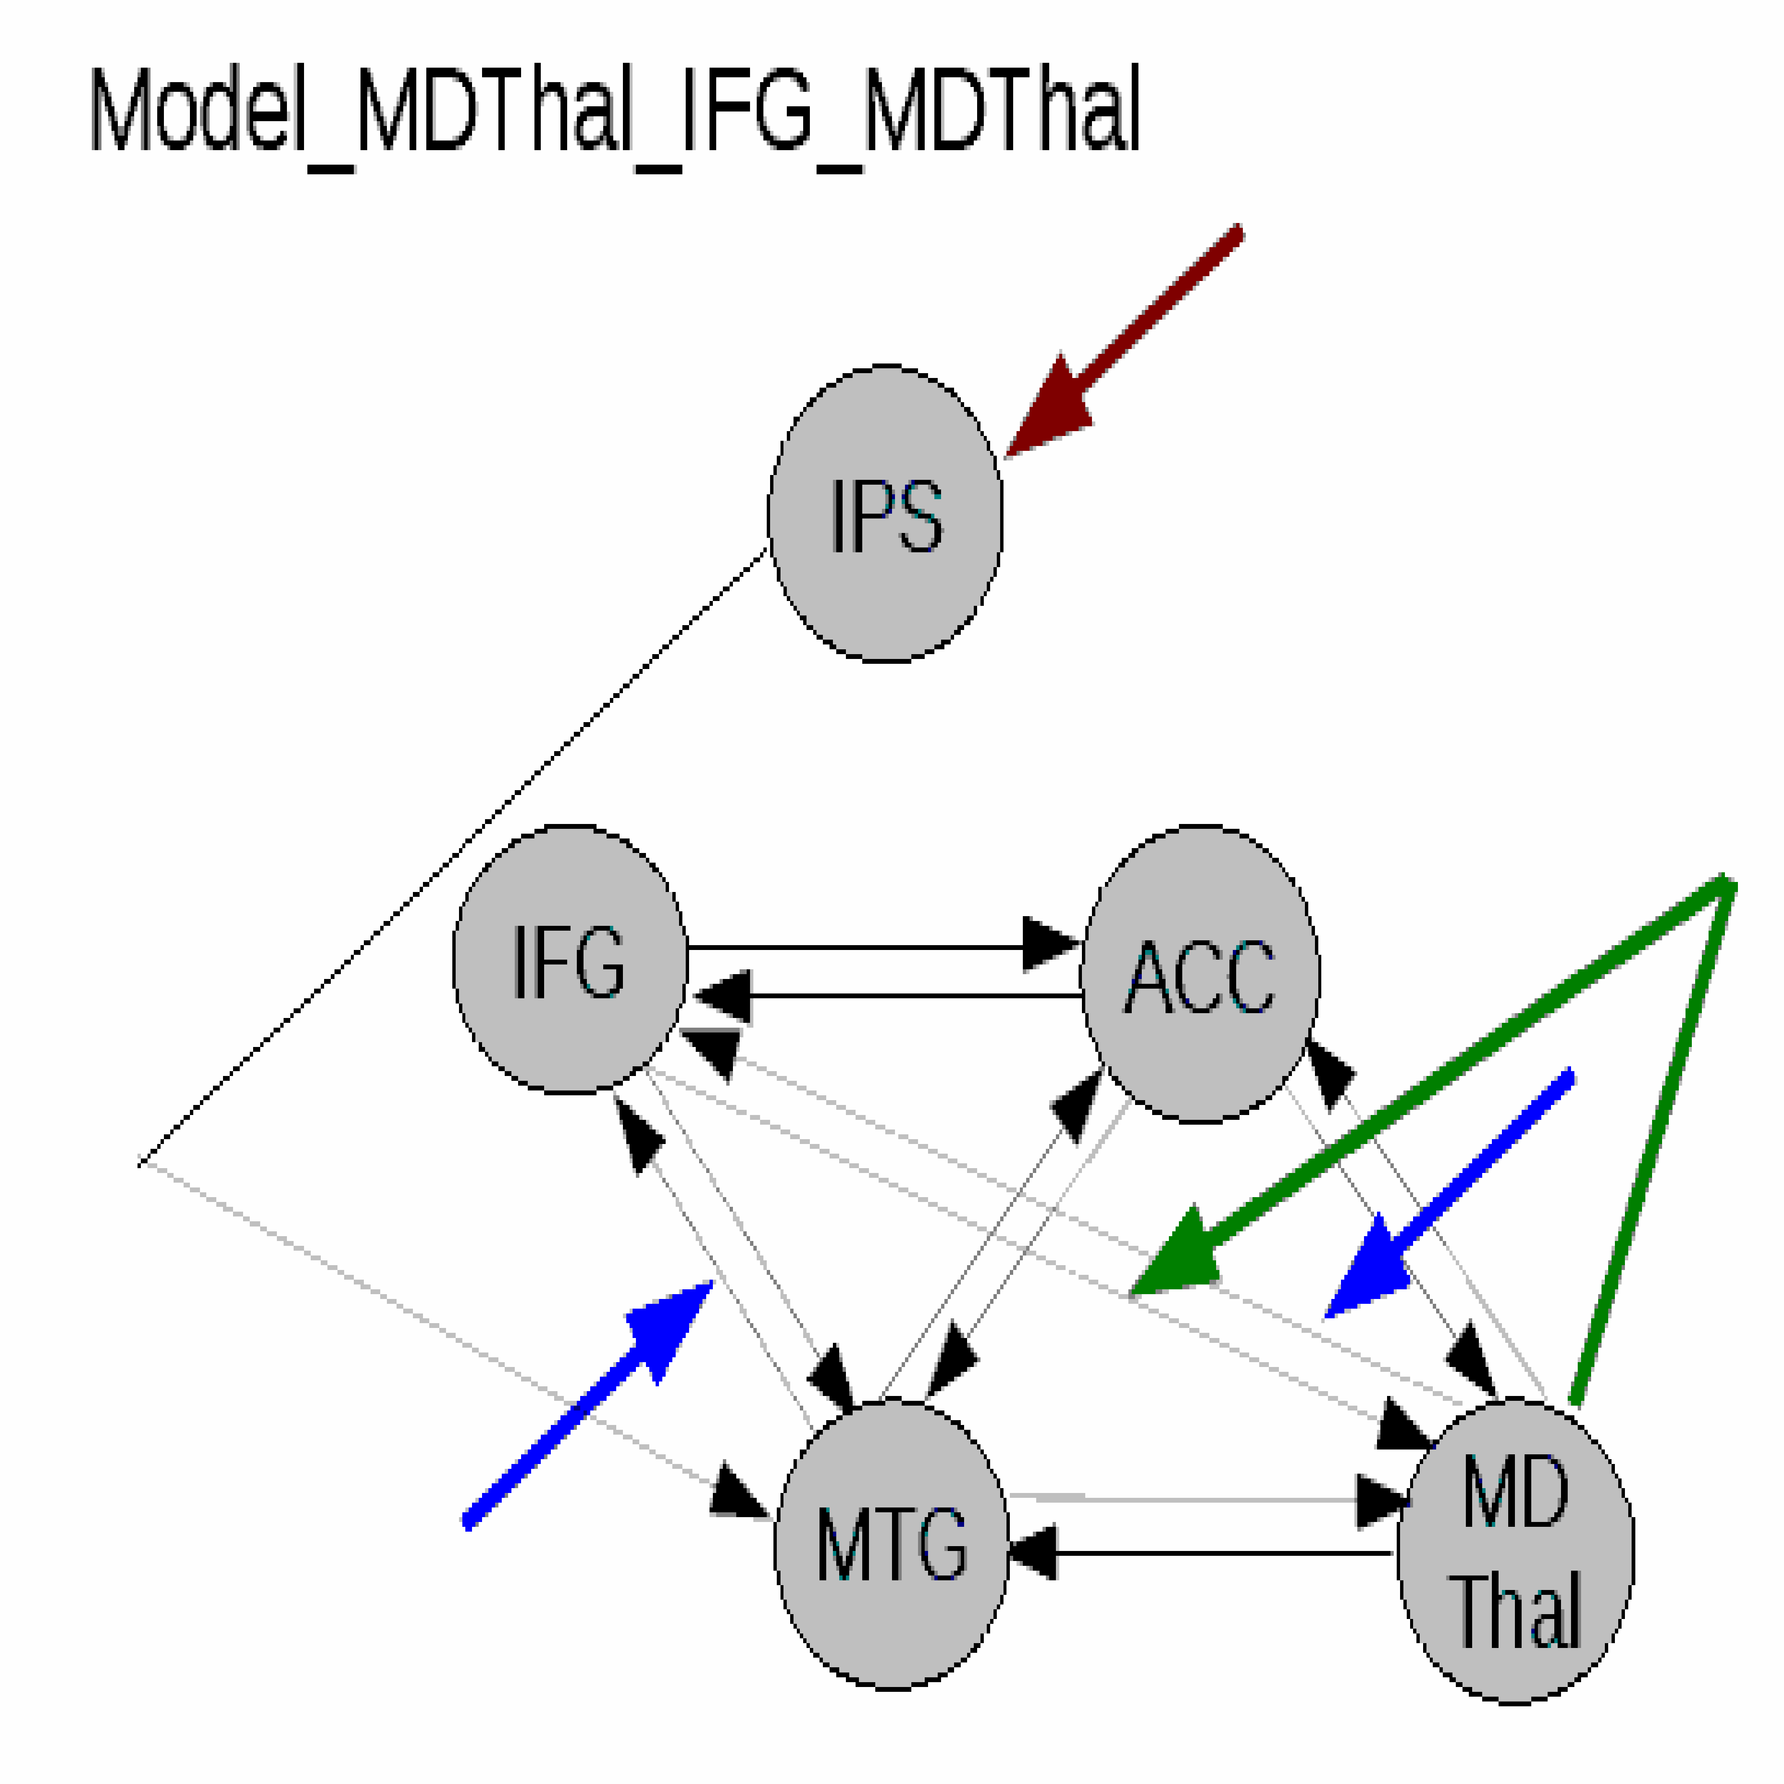
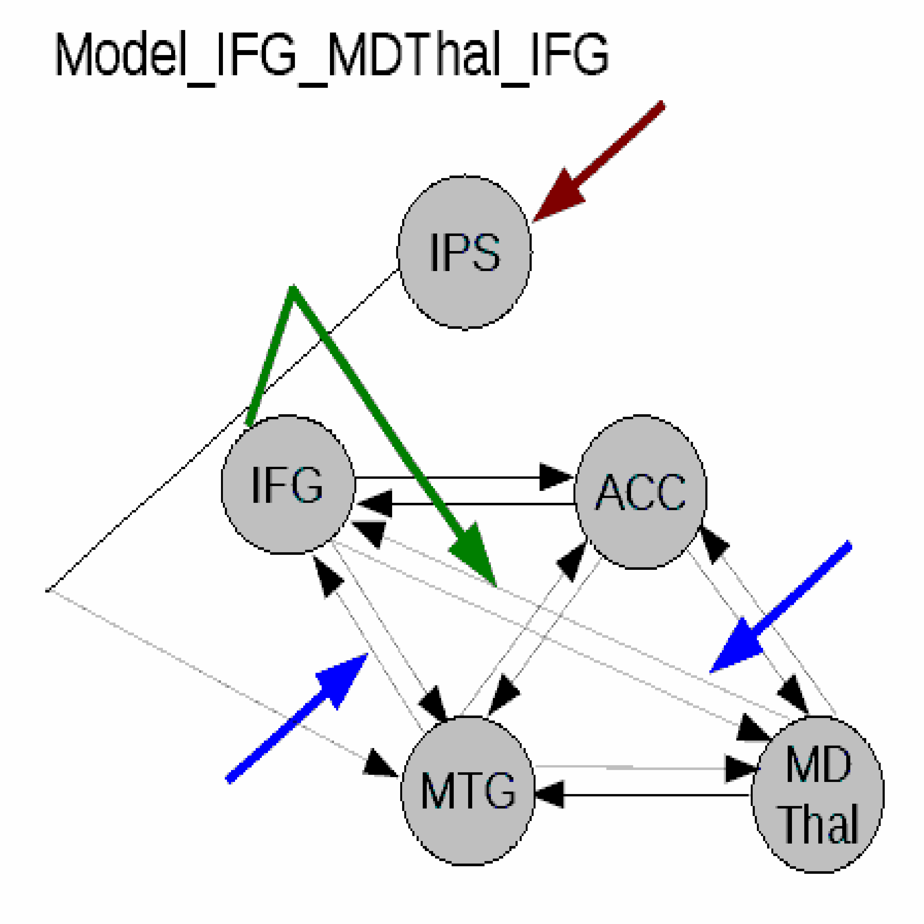
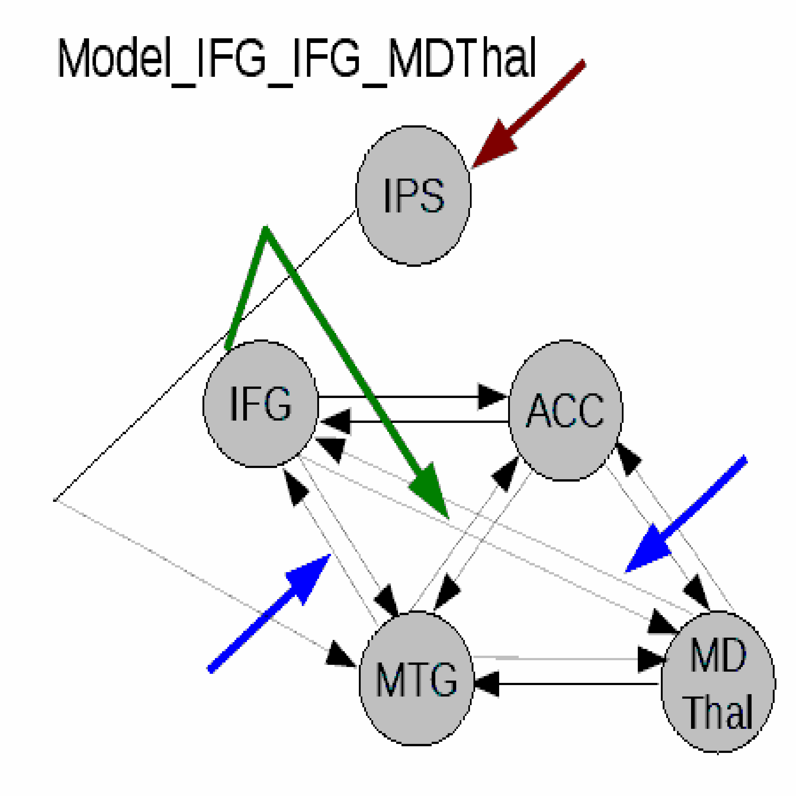
Nonlinear models
IPS Intra-parietal sulcus
IFG Inferior frontal gyrus
ACC Anterior cingulate cortex
MTG Middle temporal gyrus
MD Thalamus Mediodorsal thalamus
Endogenous connection
Modulatory input
Driving input
Nonlinear modulation
Dauvermann et al. 2013

Slide 46
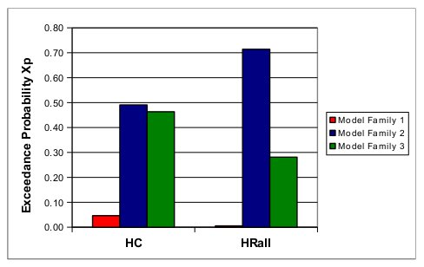
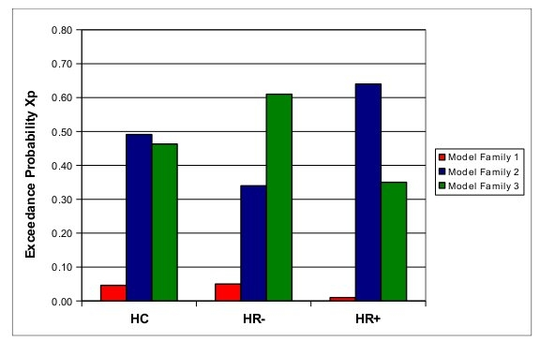
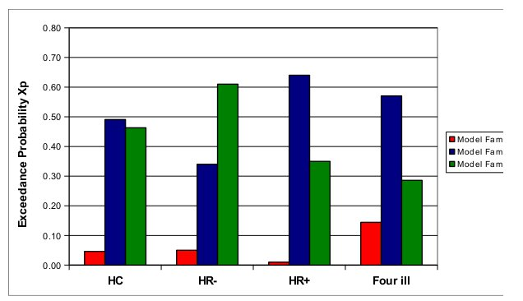
Optimal nonlinear model family
Dauvermann et al. 2013
Dauvermann et al. 2013

Slide 47

Effective connectivity during emotion inhibition in individuals with bipolar disorder
A group of mood disorders characterised by extreme shifts in mood, energy and activity levels. Mood episodes can significantly shift between elevated mood (mania) and periods of depressed mood.
Deficits in emotion inhibition are a central cognitive symptom in individuals with bipolar disorder
Emotion processing (and inhibition) can be assessed by the ability to inhibit a response when the content of the image is emotional
Increased bilateral cingulate activity during emotion inhibition in individuals with bipolar disorder compared to healthy controls among other studies
American Psychiatric Association, 2022
Nabulsi et al. 2022
Notes:
Confidential

Slide 48
Effective connectivity during emotion inhibition in individuals with bipolar disorder
Muscarinic-cholinergic system is involved in the pathophysiology in bipolar disorder
Muscarinic-cholinergic system contributes to emotional processing and is functionally altered in bipolar disorder
Doses of muscarinic-cholinergic agents, such as physostigmine, have been shown to worsen depressive symptoms and reverse mania
Nabulsi et al. 2022
Quirke et al. In Preparation
Notes:
Confidential

Slide 49
Aims and hypothesis
To increase insight into the mechanistic neurochemical basis of emotion inhibition deficits in bipolar disorder using a randomised double-blind placebo-controlled trail with physostigmine
To examine effective connectivity among the middle frontal, anterior cingulate and posterior cingulate cortices during emotion inhibition of negative valence (baseline)
Negative valence during emotion inhibition will result in reduced modulatory connection strength in:
Individuals with bipolar disorder versus healthy controls (baseline)
Individuals administered physostigmine versus placebo (drug)
Notes:
Confidential

Slide 50
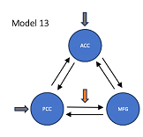
Activity-dependent changes of neural function
y
y
y
BOLD
y
λ
haemodynamic
model
activity
x₂(t)‏
activity
x₃(t)‏
activity
x₁(t)‏
neuronal
states
x
neuronal
states
Modulatory
input u₂(t)‏
integration
Modulatory
input u₂(t)‏
Neural state equation
Endogenous connectivity
Driving
input u₁(t)‏
Driving
input u₁(t)‏
t
Modulation of
connectivity
Direct inputs
t
Stephan and Friston, 2007
t
Adapted from Friston et al. 2003

Slide 51
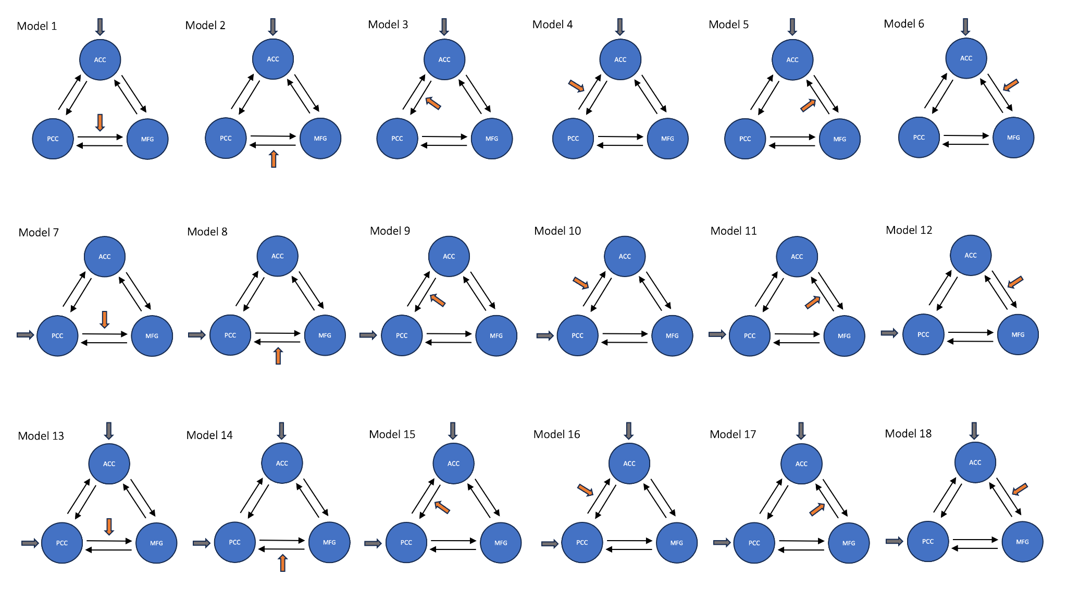
Linear Models
ACC Anterior cingulate cortex
MFG Middle frontal gyrus
PCC Posterior cingulate cortex
Quirke et al. In Preparation
Notes:
Confidential

Slide 52
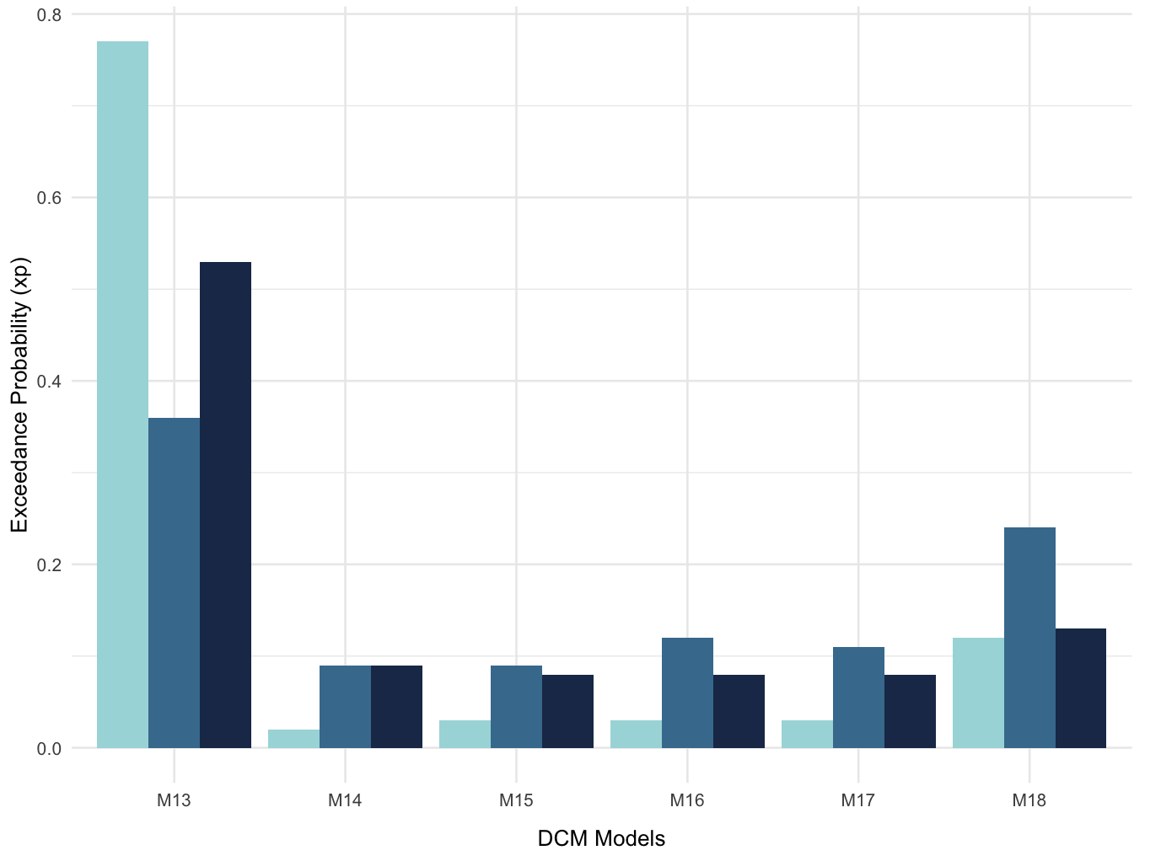
Optimal linear model
BMS results at baseline
BMS results post-challenge (drug)
Quirke et al. In Preparation
Notes:
Confidential

Slide 53

Discussion

Slide 54


Can the application of functional and/or effective connectivity to brain imaging contribute to clinical and cognitive diagnostic, predictive and treatment interventions in the future?

Slide 55


Slide 56
Summary
Main principle of functional connectivity:
Analyse data between two brain regions with temporal correlations
Main principle of DCM for effective connectivity:
Analyse data and generative models in a Bayesian framework to infer parameters and compare models
Advantages and disadvantages dependent on available data, hypothesis and a priori findings in the literature

Slide 57



Thank you very much!
Scottish Family Mental Health Study and Edinburgh High Risk Study
Clinical Neuroimaging Lab
Piyali Bhattacharya
James Cook
Aanya Malaviya
Ifigeneia Manitsa
Martin Wilson
Alan George
Collaborators:
Mike Bonsall
Dara Cannon
Jacqueline Quirke
Immune Response and Social Cognition in Schizophrenia (iRELATE)
Stephen Lawrie
Eve Johnstone
Jeremy Hall
Andrew McIntosh
Bill Moorhead
Gary Donohoe
John Kelly
Colm McDonald
Declan McKernan
Derek Morris

Slide 58
Basic Idea of DCM for EEG/MEG
Cognitive function is measured and modelled at the neural level.
DCM can be used to assess causal interactions between brain regions that explain differences between observed event-related potential/field (ERP/ERF)
To compute the posterior distributions of physiological parameters by using Bayesian model inversion and neural mass model
David et al. 2006
David and Friston, 2003
Kiebel et al. 2007
Friston and Stephan, 2007

Slide 59
High
spatial resolution
High temporal resolution
Adapted from Ryszard Auksztulewicz

Slide 60
Adapted from Ryszard Auksztulewicz
Inverse model
Where the cause (inputs)
are predicted based on the observation of the response (output) More complex neuronal model for DCM for EEG/MEG
Forward model
Where the response (output) needs to be related to the cause (inputs)
Simpler neuronal model for DCM for fMRI

Slide 61
Inverse model
Where the cause (inputs)
are predicted based on the observation of the response (output) More complex neuronal model for DCM for EEG/MEG
Adapted from Ryszard Auksztulewicz

Slide 62
High
spatial resolution
High temporal resolution
Adapted from Ryszard Auksztulewicz

Slide 63
Computational Modelling of EEG and fMRI Paradigms Indicates a Consistent Loss of Pyramidal Cell Synaptic Gain in Schizophrenia
Adams et al. 2022

Slide 64
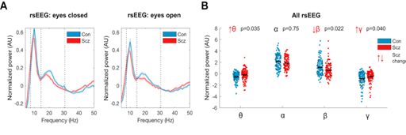
Resting-state electroencephalography (rsEEG)
(A) Mean normalised eyes closed and eyes open rsEEG power spectra (± SEM) across all channels for control subjects (Con) (n = 98; blue) and people with schizophrenia diagnoses (PScz) (n = 95; red) groups,
divided into four frequency bands (dotted lines): θ (3–7 Hz), α (8–14 Hz), β (15–30 Hz), and γ (>31 Hz).
(B) Group comparisons in mean power across both eyes closed and eyes open conditions in the θ, α, β, and γ bands are shown. The box plots show the mean, SEM, and SD. p values are Bonferroni-corrected for four comparisons.
Adams et al. 2022

Slide 65
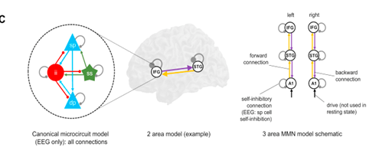
EEG Dynamic causal modelling (DCM) model structure - Canonical microcircuit model
This microcircuit (left) consists of superficial pyramidal (sp) and deep pyramidal (dp) cells, inhibitory interneuron (ii), and spiny stellate (ss) cells. They are interconnected with excitatory (arrowheads) and inhibitory (beads) connections; their self-inhibitory connections parameterise their responsiveness to their inputs, i.e., synaptic gain.
In EEG DCM, each modelled cortical area contains a microcircuit (middle); functional magnetic resonance imaging DCM uses a much simpler neuronal model. Both DCMs have self-inhibition parameters (round gray beads), which—in EEG—inhibit superficial pyramidal cells specifically. A schematic DCM diagram is explained on the right.
Adams et al., 2022

Slide 66
References
Adams, R. A., Bauer, M., Pinotsis, D., & Friston, K. J. (2016). Dynamic causal modelling of eye movements during pursuit: Confirming precision-encoding in V1 using MEG. NeuroImage, 132, 175–189. https://doi.org/10.1016/j.neuroimage.2016.02.055
American Psychiatric Association (2013). Diagnostic and Statistical Manual of Mental Disorders, 5th Edition: DSM-5, 5 edition. ed. American Psychiatric Publishing, Washington, D.C.
American Psychiatric Association (2022). Diagnostic and Statistical Manual of Mental Disorders, 5th Edition, Text Revision: DSM-5-TR, 5 edition. ed. American Psychiatric Publishing, Washington, D.C.
Boland R, Verduin M, Ruiz, P (2021). Kaplan & Sadick's Synopsis of Psychiatry (2021). 12th Ed. Wolters Kluwer Health.
Büchel C & Friston KJ. Modulation of connectivity in visual pathways by attention: cortical interactions evaluated with structural equation modelling and fMRI (1997), Cerebral Cortex, 7(8):768-778.
Byrne M, Hodges A, Grant E, Owens DC, Johnstone EC. Neuropsychological assessment of young people at high genetic risk for developing schizophrenia compared with controls: preliminary findings of the Edinburgh High Risk Study (EHRS). (1999), Psychological Medicine, 29(5):1161-1173.
Corcoran M, Hawkins EL, O’Hora D, et al. Are working memory and glutamate concentrations involved in early-life stress and severity of psychosis? Brain Behav. Published online 2020:e01616. doi:10.1002/brb3.1616
David, O., & Friston, K. J. (2003). A neural mass model for MEG/EEG: coupling and neuronal dynamics. NeuroImage, 20(3), 1743–1755.
David, O., Kilner, J. M., & Friston, K. J. (2006). Mechanisms of evoked and induced responses in MEG/EEG. NeuroImage, 31(4), 1580–1591. https://doi.org/10.1016/j.neuroimage.2006.02.034
Dauvermann MR. Whalley WC, Romaniuk L, Valton V, Owens DGC, Johnstone EC, Lawrie SM, Moorhead TWJ. The application of nonlinear Dynamic Causal Modelling for fMRI in subjects at high genetic risk of schizophrenia (2013). Neuroimage, 73:16-29.
Dauvermann, M. R., Lee, G., & Dawson, N. (2017). Glutamatergic regulation of cognition and functional brain connectivity: insights from pharmacological, genetic and translational schizophrenia research. British Journal of Pharmacology, 174(19).
Dauvermann, M. R., Moorhead, T. W., Watson, A. R., Duff, B., Romaniuk, L., Hall, J., Roberts, N., Lee, G. L., Hughes, Z. A., Brandon, N. J., Whitcher, B., Blackwood, D. H., McIntosh, A. M., & Lawrie, S. M. (2017). Verbal working memory and functional large-scale networks in schizophrenia. Psychiatry Research - Neuroimaging, 270.
Dauvermann, M. R., Whalley, H. C., Schmidt, A., Lee, G. L., Romaniuk, L., Roberts, N., Johnstone, E. C., Lawrie, S. M., & Moorhead, T. W. J. (2014). Computational neuropsychiatry - Schizophrenia as a cognitive brain network disorder. Frontiers in Psychiatry, 5(MAR). https://doi.org/10.3389/fpsyt.2014.00030

Slide 67
References
.
Dauvermann MR, Donohoe G. The role of childhood trauma in cognitive performance in schizophrenia and bipolar disorder – A systematic review. Schizophr Res Cogn. 2019;16(August 2018):1-11. doi:10.1016/j.scog.2018.11.001
Dauvermann MR, Mothersill D, Rokita KI, King S, Holleran L, Kane R, McKernan D, Kelly J, Morris D, Gill M, Corvin A, Hallahan B, McDonald C, G Donohoe. Changes in default-mode network associated with childhood trauma in schizophrenia. Schizophrenia Bulletin; 47(5):1482-1494.
Fox, M. D., & Raichle, M. E. (2007). Spontaneous fluctuations in brain activity observed with functional magnetic resonance imaging. Nature reviews. Neuroscience, 8(9), 700–11. doi:10.1038/nrn2201
Fox, M. D., Snyder, A. Z., Vincent, J. L., Corbetta, M., Van Essen, D. C., & Raichle, M. E. (2005). The human brain is intrinsically organized into dynamic, anticorrelated functional networks. Proceedings of the National Academy of Sciences of the United States of America, 102(27), 9673–8. doi:10.1073/pnas.0504136102
Friston KJ, Büchel C, Fink GR, Morris J, Rolls E. Dolan RJ. Psychophysiological and modulatory interactions in neuroimaging (1997), Neuroimage, 6(3):218-229.
Friston KJ & Stephan KE. Free-energy and the brain (2007). Synthese, 159(3):417-458.
Friston KJ, Mecchelli A, Turner R, Price CJ. Nonlinear responses in fMRI: the Balloon model, Volterra kernels, and other hemodynamics (2000). Neuroimage, 12(4): 466-477.
Fu, Z., Iraji, A., Sui, J., & Calhoun, V. D. (2021). Whole-Brain Functional Network Connectivity Abnormalities in Affective and Non-Affective Early Phase Psychosis. Frontiers in Neuroscience, 15, 682110.
Gitelman DR, Penny WD, Ashburner J et al. Modeling regional and neuropsychologic interactions in fMRI: The importance of hemodynamic deconvolution. Neuroimage (2003) 19; 200-207.
Johnstone EC, Abukmail SS, Byrne M, Clafferty R, Grant E, Hodges A, Lawrie SM, Owens DG. Edinburgh high risk study--findings after four years: demographic, attainment and psychopathological issues. (2000), Schizophrenia Research, 46(1):1-15.
Kiebel, S. J., Garrido, M. I., & Friston, K. J. (2007). Dynamic causal modelling of evoked responses: the role of intrinsic connections. NeuroImage, 36(2), 332–345. https://doi.org/10.1016/j.neuroimage.2007.02.046
Los Angeles Outpatient Center Editorial Team, 2025 [https://laopcenter.com/]

Slide 68
References
.
McIntosh AR, Grady CL, Underleider LG, Haxby JV, Rapoport SI, Horwitz, B. Network analysis of cortical visual pathways mapped with PET. (1994). Journal of Neurosience, 14(2):655-666.
McKenzie E, Matkin L, Sousa Fialho L, et al. (2022). Developing an international standard set of patient-reported outcome measures for psychotic disorders. Psychiatric Services, 73(3):249-258.
Ride J, Kasteridis P, Gutacker N, Aragon Nuthacker MJ, Jacobs R. Healthcare Costs for People with Serious Mental Illness in England: An Analysis of Costs Across Primary Care, Hospital Care, and Specialist Mental Healthcare. Appl Health Econ Health Policy. 2020;18(2):177-188. doi:10.1007/s40258-019-00530-2
Siegel-Ramsay J, Romaniuk L, Whalley H, Roberts N, Branigan H, Stanfield A, Lawrie SM, Dauvermann MR. Glutamate and functional connectivity - Support for the excitatory-inhibitory imbalance hypothesis in autism spectrum disorders. Psychiatry Res Neuroimaging. 313:111302.
Sporns O. Brain Connectivity (2007). Scholarpedia, 2(10): 4695.
Stephan KE, Kasper L, Harrison LM, Daunizeau J, dne Ouden HEM, Breakspear M, Friston KJ. Nonlinear dynamic causal models for fMRI. (2008), Neuroimage, 42(2):649-662.
Stephan KE, Penny WD, Moran RJ, den Ouden HEM, Daunizeau J, Friston KJ. Ten simple rules for dynamic causal modeling (2010). Neuroimage, 49(4):3099-109.
Uhlhaas, P. J., & Singer, W. (2010). Abnormal neural oscillations and synchrony in schizophrenia. Nature Reviews. Neuroscience, 11(2), 100–113. https://doi.org/10.1038/nrn2774
van Os J, Kenis G, Rutten BP. The environment and schizophrenia. Nature. 2010 Nov 11;468(7321):203-12.
Whalley HC, Simonotto E, Flett S, Marshall I, Ebmeier KP, Owens DGC, Goddard NH, Johnstone EC, Lawrie SM. fMRI correlates of state and trait effects in subjects at genetically enhanced risk of schizophrenia. (2004), Brain, 127(Pt 3):478-490.

Slide 69
References
.
Whalley HC, Simonotto E, Marshall I, Owens DGC, Goddard NH, Johnstone EC, Lawrie SM. Functional disconnectivity in subjects at high genetic risk of schizophrenia. (2005), Brain, 128(Pt 9):2097-2108.
http://www.fil.ion.ucl.ac.uk/spm/data/attention/
http://www.fil.ion.ucl.ac.uk/spm/doc/mfd/2012/
http://www.fil.ion.ucl.ac.uk/spm/doc/manual.pdf
Adapted from Ryszard Auksztulewicz Slides (https://www.fil.ion.ucl.ac.uk/spm/course/slides15-meeg/07_MEEG_SPM_May2015_DCM_principles.pdf)

